Slide 1
2022 Fall Faculty Meeting
“Reconnecting”
Sonia Thorn
Assistant Vice President of Academic Affairs and Facilitator
August 11, 2022

Slide 2
Faculty Meetings and Networking/Mentoring
Maria Witherell, Assistant Dean of Arts and Sciences {West Campus}
Calculator policies
Ensure that instructors are using the current textbooks for the course
Fall Adjunct Faculty Meeting (Thursday, August 11 at 5:30 pm)
Faculty Development Institute Workshop Offerings
Participate in Community Groups in Canvas
Faculty Resources
Math Department
English Composition and Literature Repository
Bio Sciences Community Group
American History Community Group
Pair a dual enrollment instructor with a full time instructor
Dr. Timothy L. Beard
President

Slide 3
Welcome and Academic Affairs Updates
Dr. Stanley M. Giannet
Executive Vice President and
Chief Academic Officer/College Provost

Slide 4
2022 Legislative Updates
Andrea Brvenik, Esq.
General Counsel

Slide 5
SB7044: Accreditation, Tenure and Transparency
Public institutions must seek a new accreditor every cycle.
Public institutions can sue accreditors when they are “negatively impacted by retaliatory action.”
Tenured faculty at public universities must undergo a “comprehensive post-tenure review” every five years.
Information on course materials and student fees at public institutions will be more accessible, and course credits will transfer more easily between public institutions.

Slide 6
SB7044: Statewide Course Numbering System
SB 7044 modified s. 1007.24, F.S., to require the maintenance of the electronic Statewide Course Numbering System (SCNS). It specified the SCNS include, for postsecondary courses, course levels, numbers, titles, credits awarded, and other identifiable information by institution and academic year, as required by Rule 6A-10.024, F.A.C., Articulation Between and Among Universities, Florida Colleges, and School Districts.

Slide 7
SB7044: Institutional Accreditation
SB 7044 created s. 1008.47, F.S., to prohibit FCS institutions and state universities from being accredited by the same accrediting agency or association for consecutive accreditation cycles. It specified that FCS institutions must seek accreditation from an SBOE-identified accreditor or association in the year following reaffirmation or fifth-year review by their current accrediting agencies. SB 7044 also specified that specialized program accreditation is excluded from the prohibition on being accredited by the same accreditor for consecutive accreditation cycles.
Once the reaffirmation or fifth-year review by the current accreditor is complete, FCS institutions will be required to provide quarterly reports on their progress of seeking accreditation from an accreditor identified by SBOE. If each SBOE-identified accreditor refuses to grant candidacy to an FCS institution, that institution must seek accreditation from an agency or association that is recognized by the U.S. Department of Education (USED). In the case candidacy status is not granted, the FCS institution may remain with its current accreditor. The prohibition on being accredited by the same accreditor for consecutive accreditation cycles will expire on December 31, 2032.

Slide 8
SB7044: Textbook Affordability
SB 7044 modified s. 1004.085, F.S., to provide requirements for lists of required and recommended textbooks and instructional materials for FCS institution and state university courses. Specifically, the bill required the lists of textbooks and instructional materials to:
Remain posted for at least five academic years.
Be searchable by the course subject, course number, course title, the name of the instructor of the course, the title of each assigned textbook or instructional material, and each author of an assigned textbook or instructional material.
Be easily downloadable by current and prospective students.
Additionally, SB 7044 modified syllabi requirements for the list of required and recommended textbooks when the course is a general education core course option identified pursuant to s. 1007.25, F.S. For these courses, and each course section, the full syllabus must be posted with the following information: course curriculum; goals, objectives, and student expectations; and assessment of student performance. This bill takes effect on July 1, 2022.

Slide 9
HB7: Individual Freedom (s1)
HB 7 amended multiple Florida Statutes related to non-discrimination in the Florida Civil Rights Act (FCRA) and Florida Education Code. It provided that it is discrimination under the FCRA for an employer to subject individuals as a condition of employment, membership, certification, licensing, credentialing, or passing an examination, to training, instruction, or any other required activity that espouses, promotes, advances, inculcates, or compels such individual to believe any of the following concepts:
Members of a race, color, sex, or national origin are morally superior to members of another race, color, sex, or national origin.
An individual, by virtue of his or her race, color, sex, or national origin, is inherently racist, sexist, or oppressive, whether consciously or unconsciously.

Slide 10
HB7: Individual Freedom (s2)
An individual’s moral character or status as either privileged or oppressed is necessarily determined by his or her race, color, sex, or national origin.
Members of one race, color, sex, or national origin cannot and should not attempt to treat others without respect to race, color, sex, or national origin.
An individual, by virtue of his or her race, color, sex, or national origin, bears responsibility for, or should be discriminated against or receive adverse treatment because of, actions committed in the past by other members of the same race, color, sex, or national origin.

Slide 11
HB7: Individual Freedom (s3)
An individual, by virtue of his or her race, color, sex, or national origin, should be discriminated against or receive adverse treatment to achieve diversity, equity, or inclusion.
An individual, by virtue of his or her race, color, sex, or national origin, bears personal responsibility for and must feel guilt, anguish, or other forms of psychological distress because of actions, in which the individual played no part, committed in the past by other members of the same race, color, sex, or national origin.

Slide 12
HB7: Individual Freedom (s4)
Such virtues as merit, excellence, hard work, fairness, neutrality, objectivity, and racial colorblindness are racist or sexist, or were created by members of a particular race, color, sex, or national origin to oppress members of another race, color, sex, or national origin.
HB 7 also provided that subjecting a student or employee in the Florida K-20 public education system to training or instruction that espouses, promotes, advances, inculcates, or compels such student or employee to believe the above-listed concepts constitutes discrimination. It also replaced “gender” with “sex” and replaced “ethnicity” with “color.”
Institutions are encouraged to take the necessary action to ensure compliance. This may require institutions to revisit required faculty and staff professional development onboarding or training requirements, tenure promotional or retention policies, and/or the course content for students enrolled in required coursework or any instruction that actively espouses, promotes, advances, inculcates, or compels faculty, staff, and/or students to believe any of the aforementioned concepts without providing such training or instruction in an objective manner. The bill takes effect on July 1, 2022.

Slide 13
SB2524: Dual Enrollment
Senate Bill (SB) 2524 modified section (s.) 1007.271(17), Florida Statutes (F.S.), to remove the requirement that only public school students be provided instructional materials for use in dual enrollment courses free of charge. In effect, all students – public school, private school, and home education – will be provided instructional materials free of charge. Additionally, SB 2524 provided that postsecondary institutions may not require payment for instructional materials costs that are eligible for reimbursement under the Dual Enrollment Scholarship Program in s. 1009.30, F.S.
Related to the Dual Enrollment Scholarship Program, SB 2524 modified the timeline for reporting and reimbursements. To receive a reimbursement, postsecondary institutions must report students within 30 days after the end of the regular registration period; FDOE must distribute reimbursements no later than 30 days upon receipt of the institutions’ submissions. The Florida Legislature appropriated $18,050,000 to support this program in Fiscal Year (FY) 2022-23 and $2,000,000 for FY 2021-22 to cover an anticipated deficit.

Slide 14
SB7: Open Educational Resources
SB 2524 amended s. 1006.73, F.S., to require all FCS institutions to ensure course registration systems prominently identify courses that utilize open educational resources (OER) and have zero textbook costs to maximize awareness and cost savings to students at least 45 days prior to the start of the term. The Zero Textbook Cost Indicator developed by the Florida Postsecondary Academic Library Network may be used for this purpose. This bill takes effect on July 1, 2022.

Slide 15
SB896: Educator Certification Pathways for Veterans – Informational
SB 896 modified s. 1012.56, F.S., to create an additional pathway for veterans to qualify for educator certification. The bill removed the requirement that an applicant for a temporary educator certificate hold a baccalaureate degree if the applicant has completed certain military service and education requirements. The effective date is July 1, 2022. Teacher preparation programs and veterans' liaisons should be aware of these changes.

Slide 16
SB2524: Open Door Grant Program
SB 2524 amended s. 1009.895, F.S., to modify the Open Door Grant Program, which provides funds to support student completion of short-term, high-demand credit and non-credit CTE programs at FCS institutions and school district career centers. Specifically, SB 2524:
Extended eligibility for Open Door funds to school districts without a career center that offer eligible integrated education and training programs;
Removed completion of a Free Application for Federal Student Aid (FAFSA) as a requirement for student eligibility; and
Allowed institutions to use Open Door funds to cover the student portion of the Student Investment approach.

Slide 17
SB2524: Linking Industry to Nursing Education (LINE)
SB 2524 created s. 1009.896, F.S., to create the Linking Industry to Nursing Education (LINE) Fund. The purpose of the LINE Fund is to incentivize collaboration between nursing education programs and health care partners to combat the growing nursing shortage in the state. The goals of the LINE Fund are to recruit faculty and clinical preceptors, increase the capacity for high-quality nursing education programs, and increase the number of nursing program graduates who are prepared to enter the workforce.
This competitive grant program will provide matching funds, on a dollar-to-dollar basis, to participating institutions that partner with a healthcare provider. The bill takes effect on July 1, 2022. The Florida Legislature appropriated $19 million for FCS institutions, school district career centers, charter technical career centers, and certain independent nonprofit colleges and universities.
FDOE has begun rule development to outline the implementation of this grant program. A rule workshop is scheduled for June 29, 2022, at 12:45 p.m. EST. Those who would like to participate can do so by registering at https://register.gotowebinar.com/register/4419109178875206413. Institutions should expect an RFA to apply for funding. FDOE will notify institutions as soon as the RFA is available.
Prepping Institutions, Programs, Employers, and Learners through Incentives for Nursing Education (PIPELINE) (SB 2524)
SB 2524 created s. 1009.897, F.S., to create the Prepping Institutions, Programs, Employers, and Learners through Incentives for Nursing Education (PIPELINE) Fund. District career centers, charter technical career centers, FCS, and SUS institutions will be allocated funds based on the performance of nursing education programs.
Performance metrics for programs include the number of nursing education program completers and the first-time National Council of State Boards of Nursing Licensing Examination (NCLEX) passage rate of the institution’s nursing education program completers. Additionally, allocations shall reward programs with first-time average NCLEX passage rates above the national average.
The Florida Legislature appropriated $20 million for school district career centers that offer licensed practical nursing (LPN) programs and $40 million for FCS institutions. FDOE has begun in rule development to administer the PIPELINE fund to institutions. A rule workshop is scheduled for June 29, 2022, at 12:00 p.m. EST. Those who would like to participate can do so by registering at https://register.gotowebinar.com/register/2556350664066848272. Institutions should expect an RFA to apply for funding. FDOE will notify institutions as soon as the RFA is available.

Slide 18
SB2524: Nursing Program Data Collection
SB 2524 amended s. 464.0195, F.S., to require the biennial gap analysis of the supply and demand of the healthcare workforce to be conducted by the Florida Center for Nursing. Additionally, SB 2524 amended s. 1004.015, F.S., to require the Florida Talent Development Council (TDC), with the support of BOG and SBOE, to develop a survey to annually report 10-year trend information on nursing education programs.
FDOE is working with BOG and the TDC to modify the 10-year trend survey data collection instrument that was used in 2021. The FDOE may request additional data from FCS institutions and school districts with postsecondary programs required for this study. Data collection is expected to occur early fall 2022. The TDC will report the results of this survey by December 1, 2022.

Slide 19
HB3: Uniform Award of Credit for Law Enforcement Training
House Bill (HB) 3 created s. 1004.098, F.S., requiring the Board of Governors (BOG) and the State Board of Education (SBOE) to adopt regulations and rules to create a process to allow eligible law enforcement officers or former law enforcement officers to earn postsecondary credit, which would be uniform across all Florida public postsecondary educational institutions, for college-level training and education acquired while serving as a law enforcement officer. The bill specified the regulations and rules must include procedures for credential evaluation and the uniform award of postsecondary credit or career education clock hours.
HB 3 established September 1, 2022, as the date by which the Articulation Coordinating Committee (ACC) must convene a 14-member workgroup to develop a process for determining equivalencies. It established March 1, 2023, as the date by which the workgroup must provide recommendations to the BOG and the SBOE. Annually, the ACC must approve and update a prioritized list of postsecondary course equivalencies and the minimum postsecondary credit or career education clock hours that must be awarded for law enforcement training and experience.
FDOE will begin working with the ACC, BOG, and Florida Department of Law Enforcement to convene a workgroup by September 1, 2022, to adopt a process. Like the process developed for the uniform awarding of military credit, FDOE may request additional data from FCS institutions and school districts with postsecondary programs to identify the most common courses and trainings for which students receive postsecondary credit or clock hours, and the specific course number and credit or clock hours awarded for these trainings.
As institutions will be required to award credit or clock hours (if applicable) to the students’ degrees or certificates, institutions should expect follow-up guidance after equivalencies are developed and adopted. The Office of Articulation, which administratively supports the ACC, will be providing additional implementation procedures in the future regarding this portion of the legislation.

Slide 20
HB3: Law Enforcement Academy Scholarship – Informational
HB 3 created s. 1009.896, F.S., the Florida Law Enforcement Academy Scholarship Program, to assist in the recruitment of law enforcement officers by providing financial assistance to trainees who enroll in a law enforcement officer basic recruit training program. The Florida Legislature appropriated $5 million to students at school district career centers and FCS institutions in approved training programs. The bill takes effect on July 1, 2022. FDOE’s Office of Student Financial Assistance will administer the scholarship program in consultation with the Florida Department of Law Enforcement.

Slide 21
HB3: Law Enforcement Reimbursement – Informational
HB 3 created s. 1009.8961, F.S., to create a reimbursement program for eligible applicants who relocate from outside the state or who transition from service in the special operations forces to become full-time law enforcement officers in Florida. Beginning in 2022-23, FDOE, in consultation with the Florida Department of Law Enforcement, shall reimburse eligible applicants for eligible expenses incurred while obtaining a Florida law enforcement officer certification. The bill takes effect on July 1, 2022. The Florida Legislature appropriated $1 million for the reimbursement program, which will be administered by FDOE’s Office of Student Financial Assistance.

Slide 22
SB722: Education for Student Inmates
SB 722 amended s. 944.801, F.S., to authorize a county or municipal detention facility or the Department of Corrections (DOC) to contract with an FCS institution to provide education services to its inmates. The bill affirmatively provides that state funds provided for the operation of postsecondary workforce programs may be expended on a state inmate with 24 months or less remaining on his or her sentence, notwithstanding s. 1011.81(4), F.S., which prohibits state funds for the Florida College System Program Fund from being expended on the education of state or federal inmates. The bill takes effect on July 1, 2022.

Slide 23
Fee Waivers/Exemptions
Disabled Veterans Fee Waiver
HB 45 created s. 295.011, F.S., to establish a fee waiver for disabled veterans who are enrolled in a postsecondary program and receive education assistance under the GI Bill, but who do not qualify for the 100 percent eligibility tier federally. Beginning in 2022-23, these students are eligible to receive a waiver in the amount that is the difference between the portion of tuition and fees authorized under federal law and the full amount of tuition and fees charged by the institution attended. The bill established a requirement that institutions report the number and value of all fee waivers granted under the program. HB 45 required the SBOE to adopt rules to implement the new tuition and fee waiver. In the coming months, FDOE will initiate rule development to outline the tuition and fee waiver implementation.

Slide 24
Homeless Youth Fee Exemption
HB 1577 modified s. 1009.25, F.S., to specify that students who meet the definition of homeless children and youths in section 725 of the McKinney-Vento Homeless Assistance Act, 42 U.S.C. s. 11434a(2), are exempt from the payment of tuition and fees, including lab fees, at school district career centers and FCS institutions. The bill specified the SBOE shall consider, in rule, that the standards under 20 U.S.C. s. 1087uu-2(a) shall be adequate to determine fee exemption eligibility. Additionally, the bill presumed that any student determined to be an unaccompanied homeless youth for the tuition and fee exemption for a preceding year to be homeless for each subsequent year unless the institution has specific conflicting information.
HB 1577 also amended s. 409.1452, F.S., to require postsecondary institutions that grant fee exemptions under s. 1009.25, F.S., to have an on-campus liaison who is, at a minimum, a knowledgeable, accessible, and responsive staff member to help with any problems related to the use of the exemption. Institutions are required to provide the liaison’s contact information to each student using a tuition and fee exemption and to the Department of Children and Families (DFC) and community-based care lead agencies. In the coming months, FDOE will collaborate with DCF to outline campus liaison implementation and initiate rule development to outline the exemption.

Slide 25
Former Foster Youth Fee Exemption
SB 7034 amended s. 1009.25, F.S., to expand the tuition and fee exemption for foster care students to include a student who was the subject of a shelter proceeding, a dependency proceeding, or a termination of parental rights proceeding, and who:
Is, or was at the time of reaching 18 years of age, in out-of-home care, rather than in the custody of the DCF as is provided for in current law;
Was adopted from DCF after May 5, 1997;
Is, or was at the time he or she reached 18 years of age, in the custody of a relative or nonrelative pursuant to s. 39.5085, F.S., or s. 39.6225, F.S.;
After reaching 14 years of age, spent at least 18 months in out-of-home care and was then reunited with his or her parents who were the subject of the dependency proceeding before reaching 18 years of age, including a student who was reunited under s. 39.8155, F.S. (reinstatement of parental rights). A student is only eligible for this tuition waiver if, in addition to the above-described factors, the student is also Pell Grant-eligible; or
Was placed in a permanent guardianship, regardless of whether the caregiver participates or participated in the Relative Caregiver Program under s. 39.5085, F.S., and remains in such guardianship until either the student reaches 18 years of age or, if before reaching 18 years of age, enrolls in an eligible institution.
Additionally, HB 7065 amended s. 409.1452, F.S., which requires DCF to work in collaboration with the BOG, FCS, and FDOE to address the need for a comprehensive support structure in the academic arena to assist current or former foster youth in making the transition from a structured care system into an independent living setting. In concert with HB 1577, FCS institutions and school districts with workforce education programs will provide campus liaison positions for current and former foster youth and students experiencing homelessness so dedicated, on-campus support is readily available. This information is required to be made available on institutional webpages, to exemption recipients, DCF, and other care lead agencies.
Lastly, the bill required each institution where a student is exempt from the payment of tuition and fees under s. 1009.25, F.S., to maintain the original documentation submitted regarding a child or young adult’s involvement in the child welfare system that confers eligibility for the tuition and fee exemption. Postsecondary institutions are prohibited from making additional requests for such documentation.
The bills authorizing the three preceding fee waivers/exemptions take effect July 1, 2022. FCS institutions and school districts with workforce education programs may need to review processes and identify required documentation for individuals who claim the waiver and/or exemption. As a reminder, ss. 1009.22(9), F.S., and 1009.23 (12)(a), F.S., specify that districts and FCS institutions may not charge or waive any fee except as authorized by law.
Technical requirements for reporting the waiver or exemption will be transmitted to college reports coordinators as soon as practical. FCS institutions are required to report the number and value of fee waivers and exemptions annually.

Slide 26
Support for Children and Youth Special Populations – Informational
In addition to amending 1009.25, F.S., related to fee exemptions, several bills that passed during the 2022 legislative session addressed services for homeless youth and former foster youth throughout K-12 and postsecondary education.
HB 1577 amended multiple Florida Statutes to expand services available to children and youth experiencing homelessness. Specifically, the bill:
Requires district school boards to issue a certified unaccompanied homeless youth a card that includes information on the youth’s rights and available benefits, and allows health care providers to accept the issued card as proof of the status as a certified unaccompanied homeless youth.
Expands the Keys-to-Independence program to unaccompanied homeless youth who meet certain requirements.
Waives fees for copies of a birth certificate for certified unaccompanied homeless youth and young adults who aged out of foster care.
Requires the Office of Program Policy Analysis and Government Accountability (OPPAGA) to study the current use of college liaisons, the number of students experiencing homelessness, students’ requested services, and student experiences.
SB 7034 amended multiple Florida Statutes regarding the duties and responsibilities of the DCF in the Relative Caregiver Program, the care of children, and the Road-to-Independence Program that are targeted at benefiting the lives of foster youth in Florida.
Additionally, HB 7065 amended multiple Florida Statutes strengthening child welfare programs. Specific areas of focus included fathers, at-risk children, including dually involved children, at-risk male students, and former foster youth.

Slide 27
SB7044: Student Fee Changes – Informational
SB 7044 amended s. 1009.23, F.S., to require all tuition and fees, and any proposed changes to them, be prominently posted on the institution’s website in a transparent and easily accessible area. It also requires public notice and e-mail notification of all enrolled students of any proposal to increase tuition or fees at least 28 days before it is voted on at a board of trustees meeting. The notice must detail how such tuition and fees are expended and the rationale and necessity for the proposed increase, and how the funds from the proposed increase will be used. Finally, any proposal or action of an FCS institution to raise, impose, or authorize any fee as authorized by law, except for tuition, must be approved by a supermajority vote of the members of the board of trustees, if approval by the board of trustees is required by general law, and at least by a supermajority vote of the members of SBOE, if their approval is required by general law. The bill goes into effect July 1, 2022.

Slide 28
SB7006: Exemption from Public Records and Meeting Requirements – Informational
SB 7006 amended s. 1004.096, F.S., to revise the definition of the term “campus emergency response” to specify the types of staff involved in emergency planning and the students, faculty, and staff who are exempted from public records. The bill also extended the scheduled repeal of the exemption to October 2, 2024, unless reviewed and saved from repeal through reenactment by the Florida Legislature. The bill takes effect on October 1, 2022.

Slide 29
SB520: Presidential Search Process
SB 520 addresses a portion of the process for selecting a new president for both state universities and Florida College System institutions. Specifically, the bill requires personal identifying information for applicants and related meeting records to be confidential with respect to public records for applicants seeking to become the president of a state university or Florida College System institution. The exception to this is the information for the final group of applicants, when that group is established or 21 days before the meeting where the final vote for president is taken, whichever is earlier. The legislation went into effect on March 15, 2022.

Slide 30
House Bill 233
The bill adds requirements designed to protect the expression of diverse viewpoints at Florida College System (FCS) institutions and state universities. The bill:
Requires each FCS institution and state university to annually assess the intellectual freedom and viewpoint diversity at that institution using a survey adopted by the State Board of Education (SBE) or the Board of Governors of the State University System (BOG), as applicable. The SBE and the BOG must publish the results by September 1, 2022, and each September 1 thereafter.
Prohibits the SBE and the BOG, and FCS institutions and state universities, from shielding students, faculty, or staff from protected free speech.
Includes in the definition of protected expressive activities faculty research, lectures, writings, and commentary, whether published or unpublished. The bill clarifies that expressive activities do not include defamatory speech.
Authorizes a student to record video or audio of class lectures for personal educational use, in connection with a complaint to the public institution of higher education where the recording was made, or as evidence in, or in preparation for, a criminal or civil proceeding.
Modifies the cause of action for violations of student expressive rights to authorize a cause of action for persons injured by violations of specified rights to free speech activities, and adds a cause of action for violations related to the recording and publication of classroom lectures.
The bill requires that state university student government associations provide elected or appointed officers a direct appeal to a senior university administrator of any discipline, suspension, or removal from office. In addition, the bill requires all FCS institutions and state universities to adopt student codes of conduct that meet a set of minimum due process protections for students and student organizations.

Slide 31
House Bill 233
House Bill 233, which was adopted by the Florida Legislature during the 2021 session, amends existing state law to add five new provisions. They are:
Requiring the Board of Governors, which oversees Florida’s public universities, to develop a survey meant to measure the intellectual freedom and viewpoint diversity among students, faculty members and staff members at Florida’s universities. The survey will be conducted annually, starting Sept. 1, 2022.
Prohibiting the Board of Governors and universities from shielding students, faculty or staff from protected free speech, which may include speech they find uncomfortable, unwelcome, disagreeable, or offensive.
Allowing students to record audio and/or video of class lectures for their own personal educational use, to use as part of a complaint to the university, or to use as evidence in or preparation for a criminal or civil proceeding.
Providing Student Government officers who have been disciplined, suspended or removed from office the right to directly appeal the decision to a senior university administrator.
Requiring all public universities in Florida to adopt student codes of conduct that provide certain due process protections.

Slide 32
Technology Updates
Robert Chapa
Executive Director of Enterprise Systems
Rick Sanders
Director of Network Security
Breanna Perry
Associate Dean, E-Learning and Instructional Technology

Slide 33
Help Desk Technical Support/FAQs
Need Help?
Contact the Helpdesk
helpdesk@phsc.edu or 727-816-3311
Signing in to: myPHSC Intranet, Email, Canvas
Go to www.phsc.edu and click on myPHSC
Click Employee
Enter your myPHSC email (username@phsc.edu and password)
On the Intranet Portal, Click on the College Email or Canvas
Forgot Password?
Go to myPHSC and click “Reset your password”
Enter your Employee Email, the randomized symbols and click Next
Select “I forgot my password” and click Next
Complete your account verification (Multi-Factor Authentication) and change your password
Placing a Support Ticket?
Sign into the myPHSC Intranet
Scroll down to Support and click on “IT Help Desk”
Click on “New Support Ticket”
Fill out your support ticket
Faculty Grading/Attendance
In myPHSC, click on myCSRS/Grading
Sign in using your employee ID and PIN
For detailed instructions on entering Grading or Attendance, go to the MIS Sharepoint (https://phsc0.sharepoint.com/sites/managementinformationservices)
Need Office365?
Sign into the myPHSC, under remote productivity, Click “Office365 Apps”
EIT Contact:
elearningtechsupport@phsc.edu

Slide 34
Network Security
Need Help?
Contact the Helpdesk
helpdesk@phsc.edu or 727-816-3311
Password Requirements
Must be a minimum of 8 characters
Must meet complexity requirements (numbers, capital and lowercase letters, and symbols)
Must be changed every 60 days, the last 10 passwords are remembered
Password Reset: https://passwordreset.microsoftonline.com
Multi-Factor Authentication (MFA)
All users are required to use MFA to provide an additional layer of account security
MFA is necessary to comply with auditor and insurance requirements
MFA for Mircsoft 365, Windows desktops, and VPN connections is provided by DUO Security
MFA methods include: Mobile app (easiest) and call/text
Manage Duo (MFA) Devices: https://phsc.login.duosecurity.com/devices
Security Awareness Training
All users are required to take security awareness training through Knowbe4 annually
The next training campaign begins on September 6, 2022 and will be due for completion by October 7, 2022
E-Mail Security Tips
Don’t trust display names – check the sender’s email address before opening a message—the display name might be fake)
Check for typos – spelling mistakes and poor grammar are typical in phishing emails. If something looks off, flag it.)
Look before clicking – hover over hyperlinks in genuine-sounding content to inspect the link address)
Read the salutation – if the email is addressed to “Valued Customer” instead of you, be wary. It’s likely fraudulent.
Review the signature – check for contact information in the email footer. Legitimate senders always include them.
Beware of threats – Fear-based phrases like “your account has been suspended” are prevalent in phishing emails.

Slide 35
EIT Engage: What’s New in Canvas? 9/23 - 11AM UDOIT 10/19 - 3PM QM Course Review Process 11/17 - 1PM
Notes:
Next, we have Jennifer Veloff Assoc…., her and her team have been very busy working with faculty to develop online model courses and to certify and recertify instructors to be able to teach online…Thank you 6:00-6:05

Slide 36
AFC Updates
Mildred Diaz-Santiago
AFC/PHSC Chapter President

Slide 38
Faculty Safety Awareness and Training
David McCain
Director, College Safety and Security

Slide 39
Objectives
Safety Awareness: General Tips
Safety Awareness: Evacuations
Emergency Response/Procedures
Resources – Internet
Door Locks – Electronic
Panic Alarms/Devices
Covid-19

Slide 40
Safety Awareness: General

Slide 41
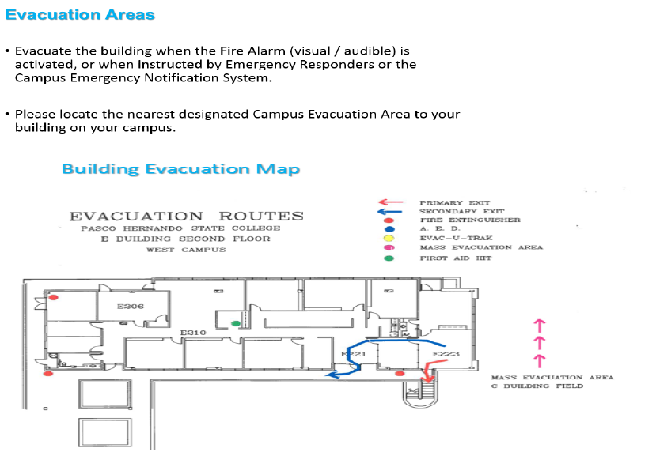
Safety Awareness: Evacuations

Slide 42
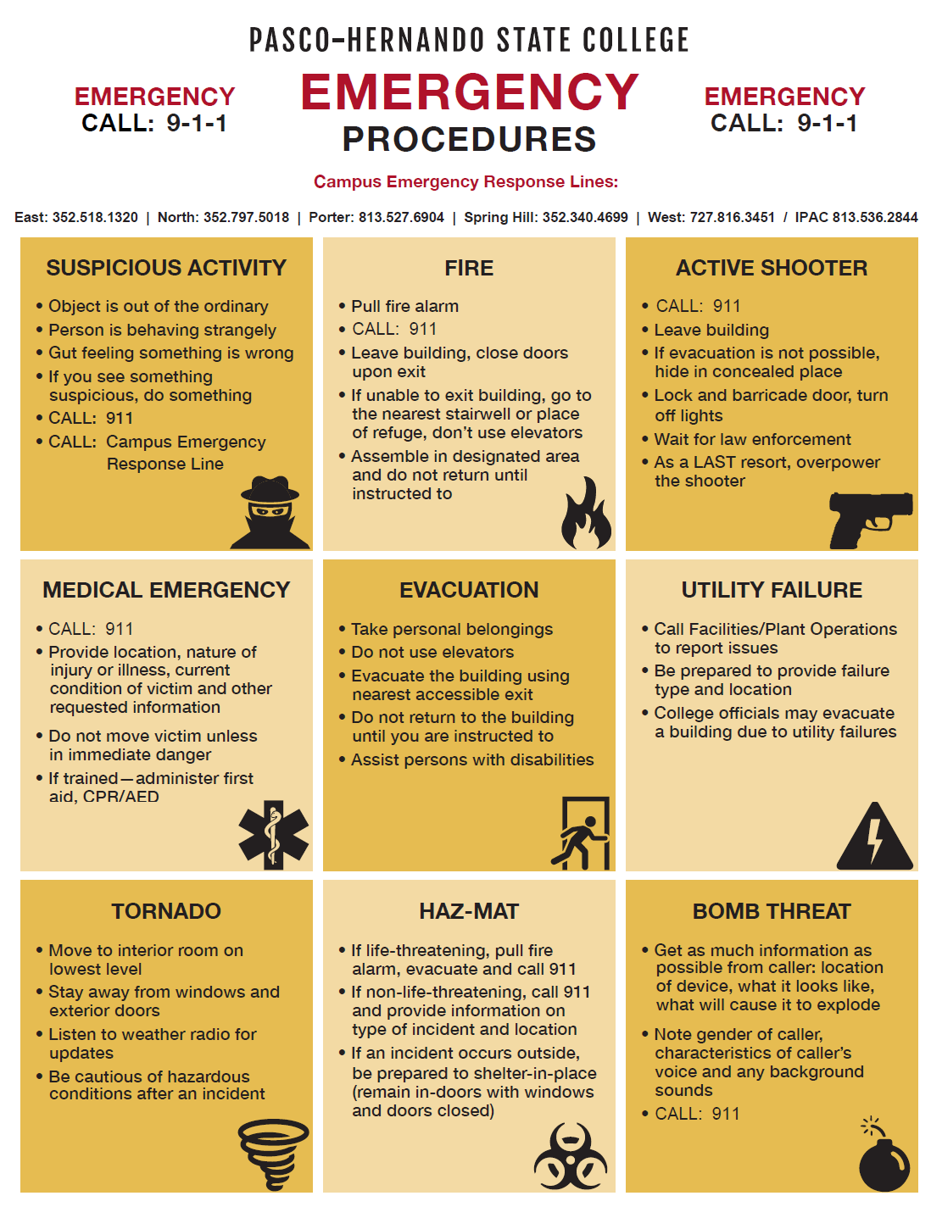
Emergency Response/Procedures
Guidelines:
Active shooter
Bomb Threat
Crime in Progress
Evacuation
Explosion
Fire
Hazardous Material Spill
Lockdown/Shelter in Place
Medical Emergency
Sexual Assault
Suspicious Activity or Package
Utility Failure
Weather Emergency

Slide 43
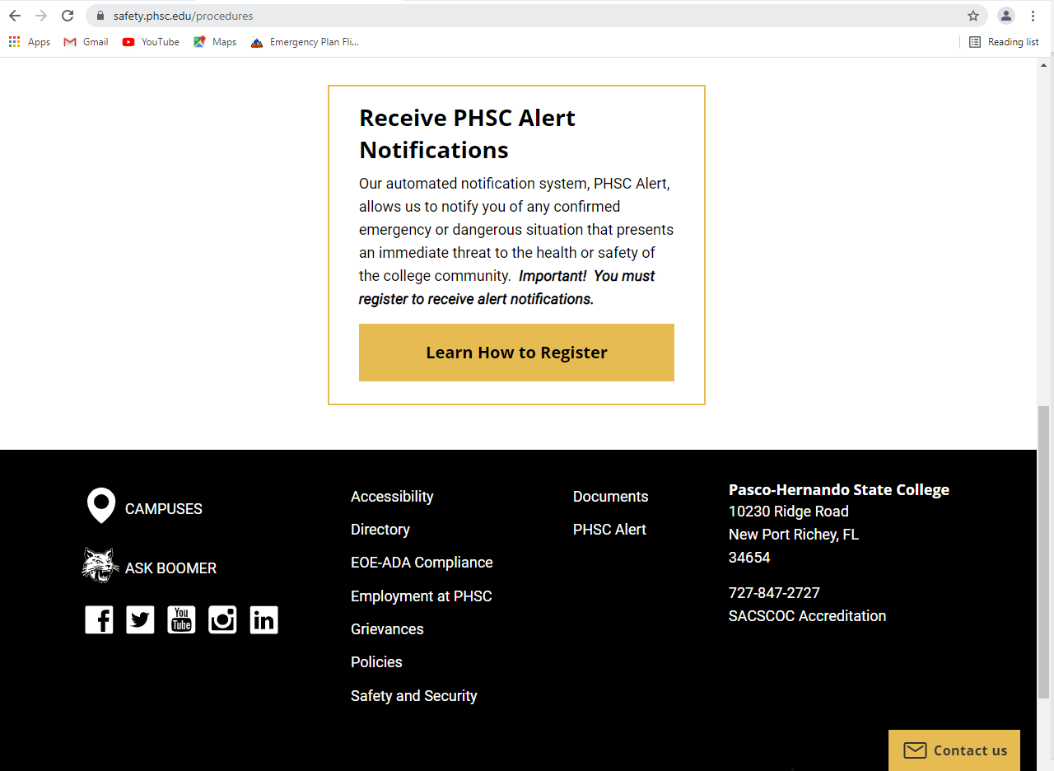
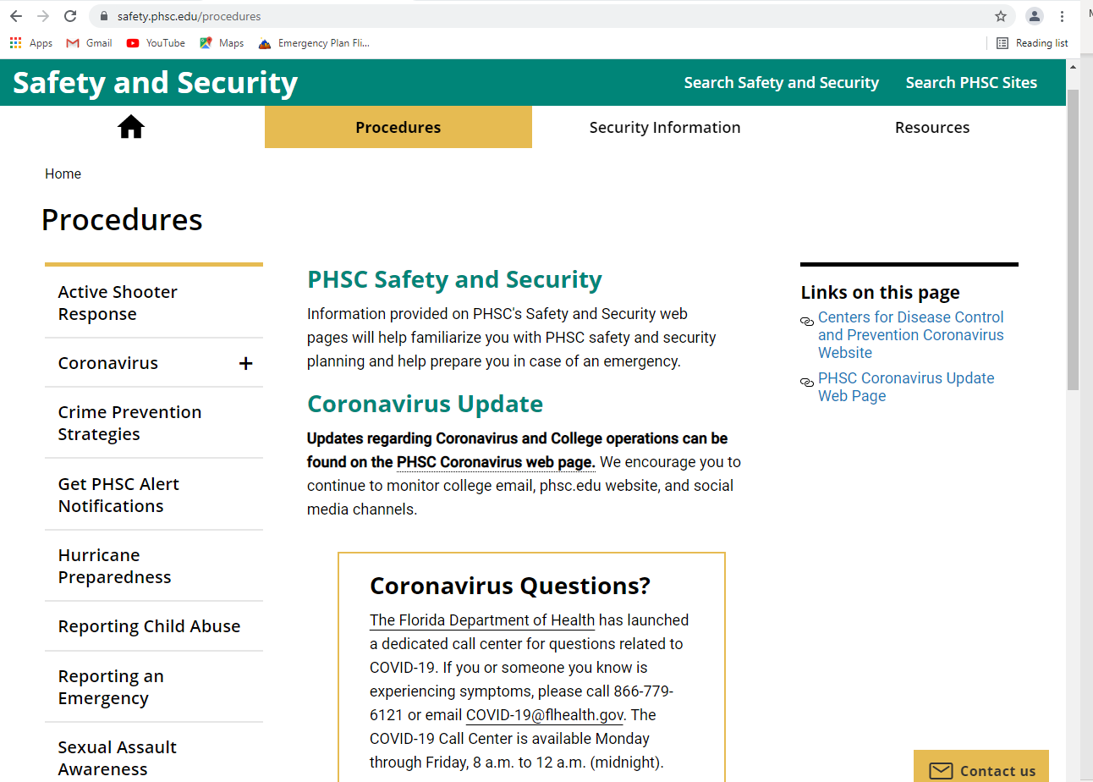
Internet Resources
Resources are available by going to the Safety and Security webpage on the College website.
Additional Resources are available in “Documents”

Slide 44
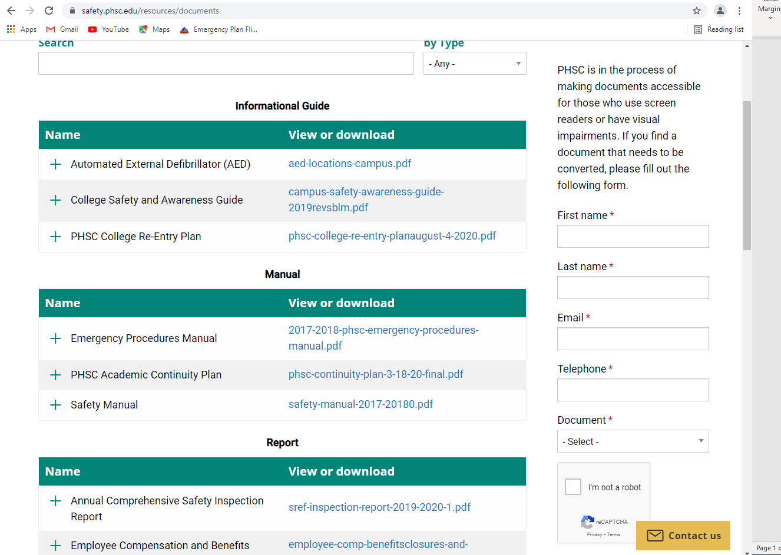
Internet Resources – Documents Page
Additional Resources:
College Safety and Awareness Guide
Campus Emergency Response Line – numbers
Campus Security – numbers
Emergency Response Guides
Emergency Procedures Manual
Safety Manual
College Re-Entry Plan
Campus AED Locations
Additional Coronavirus Information

Slide 45
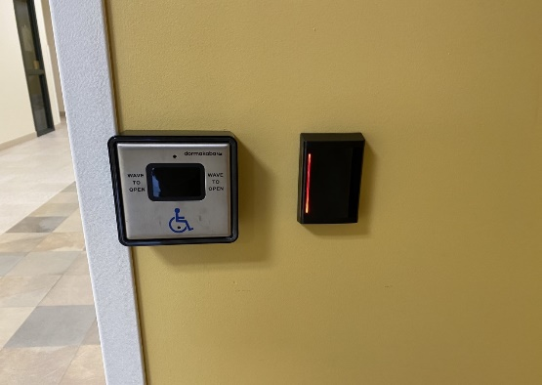
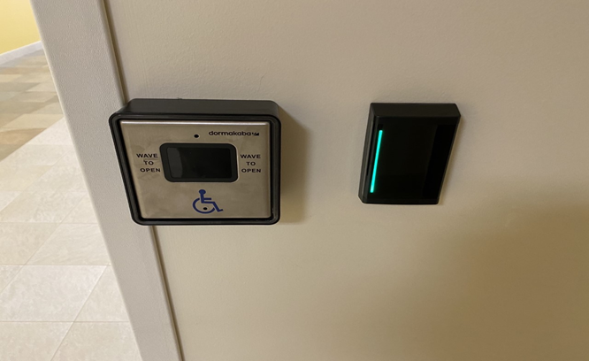
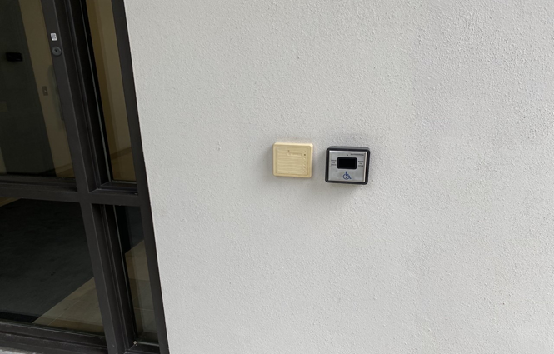
Faculty Meetings and Networking/Mentoring
Maria Witherell, Assistant Dean of Arts and Sciences {West Campus}
Electronic Door Locks
Calculator policies
Ensure that instructors are using the current textbooks for the course
Fall Adjunct Faculty Meeting (Thursday, August 11 at 5:30 pm)
Faculty Development Institute Workshop Offerings
Participate in Community Groups in Canvas
Faculty Resources
Math Department
English Composition and Literature Repository
Bio Sciences Community Group
American History Community Group
Pair a dual enrollment instructor with a full time instructor
Hands Free
Handicap access is motion activated
Door locks are activated by ID Badge
Contact Facilities for door access on your ID Badge.

Slide 46
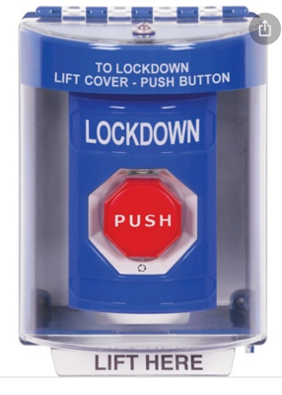
Panic Alarms/Devices
Panic Button:
Under Office Desk/In Bunker
Lock-Down Button:
Located in the Provosts' offices, Deans Office and other strategic areas on each campus

Slide 47
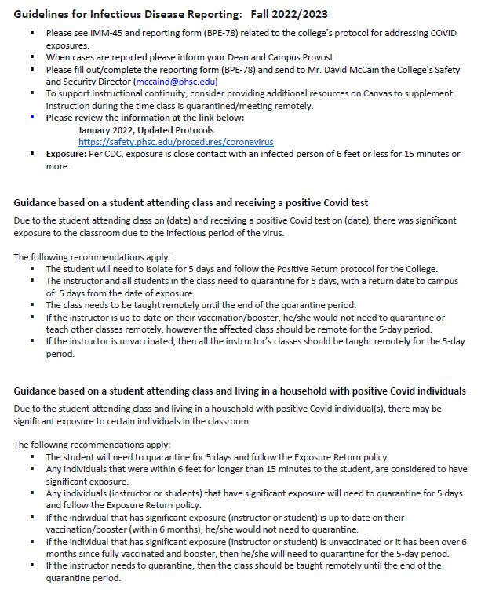
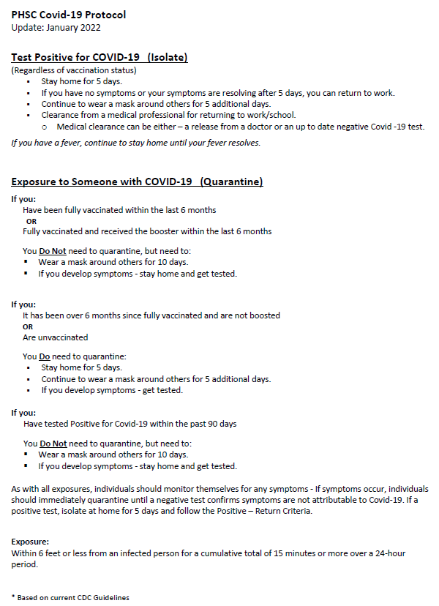
Infectious Disease:Covid-19

Slide 48
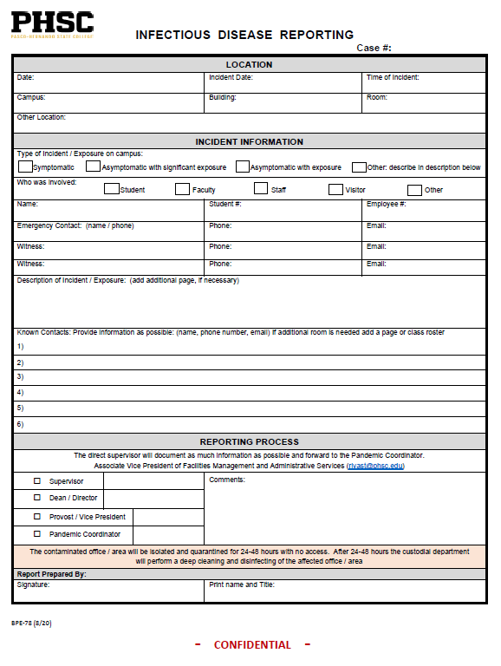
Infectious Disease:Covid-19
BPE-78 Reporting Form:
The form needs to be filled in as
complete as possible for adequate
Contact Tracing and Reporting.
Reporting Process:
Initiating Person (Staff / Faculty)
Supervisor / Department Head
Campus Assistant or Associate Dean / Dean
Provost / VP
Pandemic Coordinator
Director of College Safety and Security
Date:
Date of Incident
Date of Reporting
Location:
Campus/Building/Room
Symptomatic or Not
Name:
Contact Information
Phone/email/Student ID #
Incident Narrative – as detailed as possible
Contacts / Exposures:
Contact information for exposures
Name/phone/email
Comments: If any
Print and sign

