Slide 1
Response to Behavioral Health
Prince Georges County Sheriff’s Office

Slide 2
Objectives
Deputies will become more familiar with behavior health concerns and its risk assessment.
Deputies will identify De-escalation techniques and how to apply them when dealing with a mentally disturbed person.
Deputies will be able to identify the different responses to court ordered petitions Vs. On-view petitions.
Deputies will be able to properly fill out an emergency petition.
Deputies will learn Defensive Tactics techniques to safely take individuals into custody.

Slide 3
August 29, 2002
PFC Elizabeth Magruder and Sergeant James Arnaud were shot and killed while attempting to serve a Psychiatric Petition on an individual in a home in the 9300 block of Lynmont Drive in Adelphi at 9:30PM. The subject retreated to a rear bedroom and opened fire with a handgun. Sergeant Arnaud was shot in the throat and PFC Magruder was shot in the back of the head.

Slide 4
Logan released from custody

Slide 5
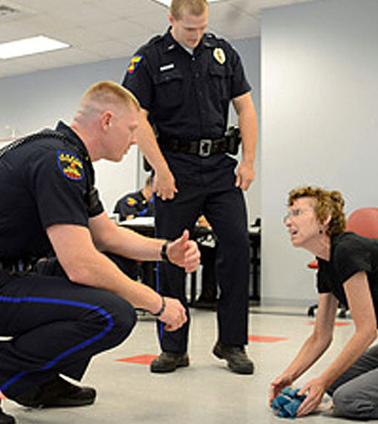
INTERACTIONS WITH PERSONS SUFFERING FROM MENTAL DISORDER
While there are most common types of interactions with people who have mental illnesses, No single policy or procedure can address all the situations in which Deputies and other Agency personnel may be required to aid persons who have mental illnesses.

Slide 6
INTERACTIONS Cont.
It is the policy of the Office of the Sheriff to ensure a consistently high level of service is provided to all persons with whom contact is made, including those who may have mental illnesses. Agency personnel will afford persons who have mental illnesses the same rights, dignity and access to government and other community services to all citizens
It is the policy of the Office of the Sheriff that no less than three (3) deputies, or a Deputy with assistance from at least two other public safety personnel, shall service an Emergency Petition Order.

Slide 7
??What is an Emergency Evaluation petition??
A process by which an individual suspected of having a mental disorder is evaluated by a mental health professional in a clinical setting
Only a mental health professional can conduct an official evaluation for persons suspected of a mental disorder.

Slide 8
What is an Emergency Petition Service? ( EPS Order)

Slide 9
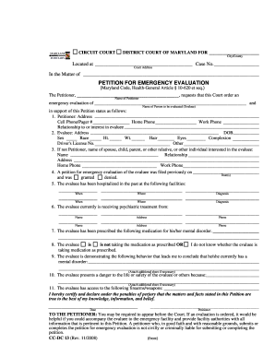
Emergency Petition Service
A court requiring an emergency evaluation of an individual who is believed to be suffering from a mental disorder and in clear imminent danger of causing bodily harm to themselves or someone else. The person (“Evaluee”) is taken into custody and examined by a doctor to determine if he/she meets the criteria for admission to a Psychiatric Facility.
Notes:
There is no expiration date when a mental health professional or law enforcement officer signs the petition.

Slide 10
Emergency Petition process
Court Review- The petitioner shall present the petition to the court for immediate review
Endorsement- After review of the petition, the court shall endorse the petition if the court finds Probable Cause to believe that the emergency evaluee has shown the symptoms of a mental disorder and that the individual presents a danger to the life or safety of the individual or of others.
If the courts does not find probable cause, the court shall indicate the fact on the petition, and no further action may be taken under the petition.
DEPUTIES SHALL TAKE INTO ACCOUNT THE PROBABLE CAUSE OF THIS ORDER AND SHALL ACT UPON IT REASONABLY.

Slide 11
Serving an Emergency Petition
Due to the nature of an Emergency Petition, Law requires any peace officer attempting to serve an emergency petition to caution the petitioner.
A peace officer shall explain to a physician, Psychologist, clinical social worker, licensed clinical professional counselor, clinical nurse specialist in psychiatric and mental health nursing. Psychiatric nurse practitioner, a licensed clinical marriage and family therapist, or a health officer or designee of a health officer, who presents a petition to the peace officer:
A. the serious nature of the petition; and
B. the meaning and content of the petition
Notes:
If the Deputy must act as the petitioner, he or she shall notify both the dispatcher and the designated hospital prior to transport to ensure that the required facilities are available. The following procedures shall be followed:
• Obtain supervisory approval to initiate the petition
• Take custody of the individual in the same manner as a prisoner under arrest
• Obtain the assistance of a second Deputy or other public safety officer to facilitate transport
• Transport the individual to the closest designated hospital
• Consult with the hospital staff and complete a petition for emergency evaluation using Maryland District Court Forms #DC 13 and #DC14
• Remain with the individual until a physician has taken custody of him or her, unless the physician requests that the Deputy remain because of the violent nature of the individual
• Complete a Case Report
• Obtain a copy of the petition and attach it and all accompanying paperwork in accordance with the procedures outlined in 4-121.3. e (EPS Orders).

Slide 12
Serving an Emergency Petition
Following the explanation and nature of the emergency petition Deputies shall inquire the following information but not limited to;
Does the subject have any weapons
Pets
Military background
History of violence
History of Violence with police
Will the Evaluee resist being handcuffed
If there is any other important information that would aid the deputies for a peaceful resolution

Slide 13
Serving an Emergency Petition
Upon contacting the subject who has an active emergency petition order deputies shall:
A. At the earliest opportunity, place the subject in custody with the handcuffs properly applied with their hands to the rear to reduce the potential for resistance, which may cause injuries.
B. Explain the order to the subject and advise them that they will be going to the hospital.
Answer any questions and maintain a professional attitude to De-escalate, avoid or minimize the Use of Force.
It is imperative to place the subject in handcuffs at the earliest opportunity to avoid the potential of the subject harming themselves or others. IT’S THE REASON YOU ARE THERE!!!!

Slide 14
Recognizing the Characteristics of Mental Illness or Disorder when responding to calls

Slide 15
Characteristics
Many people with mental illnesses control symptoms successfully with the use of medications
Many people do not have access to mental health services
Many people may have access to mental health services and often fail to take their medication
Many people do not recognize that they are ill, and can experience unfamiliar psychiatric difficulties

Slide 16
Recognizing the characteristics
Deputies and other personnel must be prepared to deal with situations involving persons who have mental illnesses and know how to respond to these situations in an appropriate and sensitive manner.
Time, Distance, and De-escalation is essential in these encounters.
Recognizing that symptoms may indicate mental illness will help deputies decide on an appropriate response and disposition.

Slide 18
Recognizing cont.
Symptoms of different mental illnesses may include, but are not limited to:
Disorientation
Loss of memory ( identity, time or place)
Delusions ( Describing unrealistic physical symptoms)
Displaying inappropriate or impulsive behavior/excited delirium
Hallucinations
Depression
Confusion
Incoherence ( Never assume they understand)
Extreme paranoia ( Feeling accused, plotted against)

Slide 19
Recognizing cont.
Deputies coming into contact with individuals exhibiting symptoms of mental illness shall use extreme caution.
Many of these symptoms represent internal, emotional states that are not readily observable from a distance but are noticeable in conversation with the individual.
Deputies coming into contact with individuals exhibiting these symptoms is not expected to diagnose a mental illness, but to decide on the appropriate response to the individual and situation.

Slide 20
Responding to calls
Deputies should obtain as much information as possible to assess and stabilize the situation.
Deputies should identify the nature of the problem behavior and/or events that may have precipitated the persons behavior and particularly, the presence of weapons.
While making contact subjects in mental health incidents deputies shall follow the guidelines according to the General Orders Manual and make every attempt to keep the situation stabilized.
If the deputy make the decision to initiate an emergency evaluation petition, the deputies shall as early as possible place the subject in restraints to avoid any risk of harm to themselves or others.

Slide 21
Immediate tools on your Duty belt and your personal weapons.
ASP Baton
OC Spray
Handcuffs
Ripp Hobble
Hands & Feet

Slide 22
Wrap System Application

Slide 23
Questions????

Slide 24
Test/Exam
1. A Deputy along with the assistance from at least one other public safety personnel, shall service an Emergency Petition Order. (T/F)
2. _____, _____, and ________ is essential in these encounters. (Fill in the blank)
3. Upon contacting the subject who has an active emergency petition order deputies shall at the earliest opportunity, place the subject in custody with the handcuffs properly applied with their hands to the rear to reduce the potential for resistance. (T/F)
4. It is the policy of the Office of the Sheriff to ensure a consistently high level of service is provided to all persons with whom contact is made, including those who may have mental illnesses. (T/F)
5. A Court ordered Emergency Petition expires in how many days?

