Slide 1

WELCOME TO THE
ADDISON POLICE DEPARTMENT
CRIME FREE MULTI-HOUSING PROGRAM

Slide 2
The Addison Crime Free
Multi-Housing Program
Keeping Illegal Activity
Out Of Rental Property
Property Managers * Residents * Law Enforcement

Slide 3

ADDISON POLICE DEPARTMENT
VIDEO

Slide 4


Slide 5

ADDISON, ILLINOIS
Population – 36,942
1,152 Rental Properties
4,081 Rental Units
762 Landlords

Slide 6
DISCLAIMER:
While we will address legal information in general, the law deals with “specific facts” presented in each situation. The information presented here should not be relied upon as a substitute for legal advice.
Always contact an attorney.

Slide 7


CONGRATULATIONS … YOU’RE A LANDLORD!!!
NOW WHAT ???

Slide 8

THE GOOD

Slide 9
THE BAD …
Your tenants might complain to you about …
Theft
Damaged Property
Drug Dealers/Users
Gang Members
Loud, Rude, and
Inconsiderate Neighbors
Etc.

Slide 10
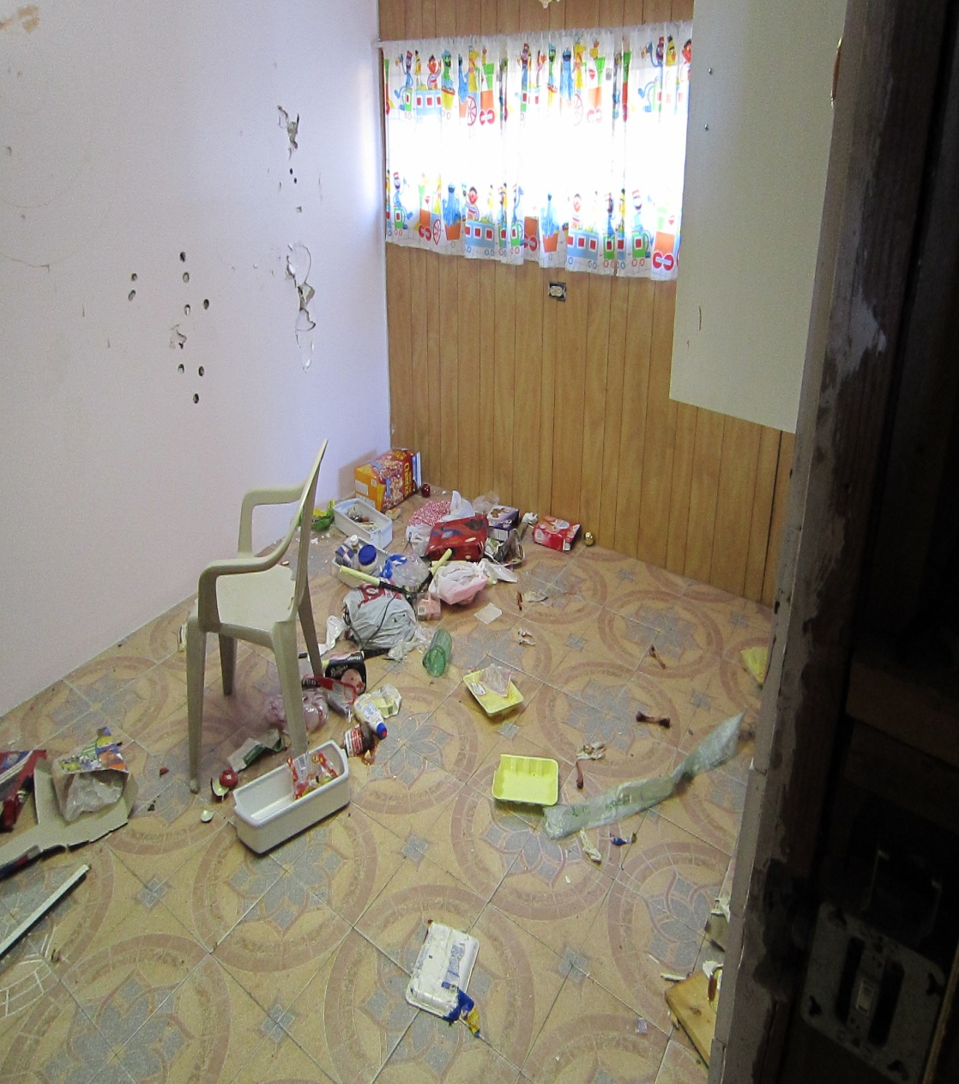
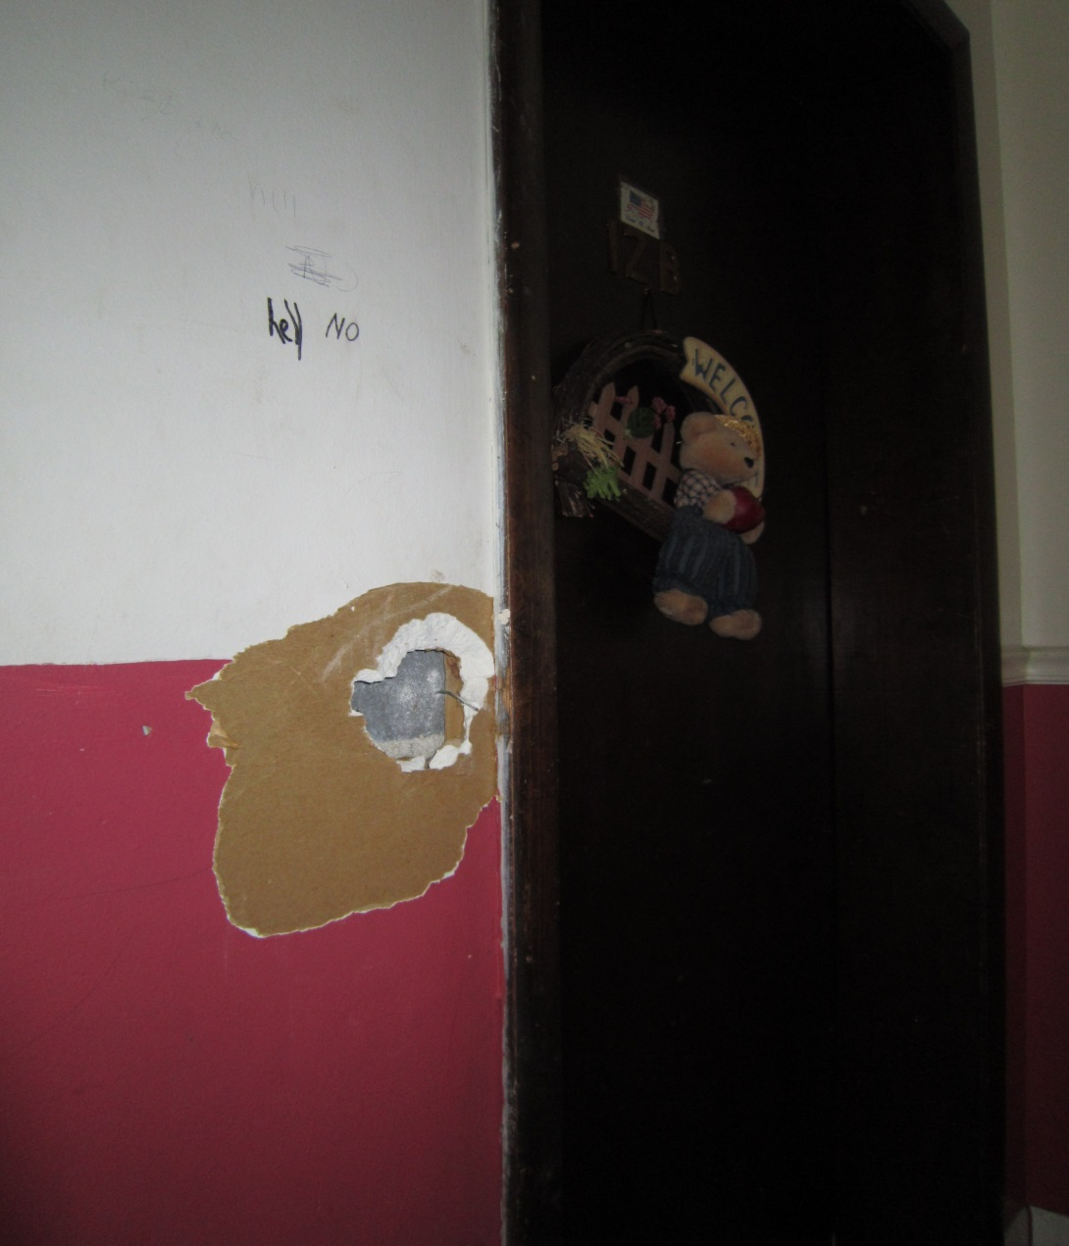
THE UGLY …

Slide 11

We all have to work together

Slide 12
Crime Free
Multi-Housing Program
(CFMH)
What is it and how does it work?

Slide 13
CFMH
Started in Mesa, AZ Oct. 1992
Addison began using the program in 2009
Now used by approximately
2000 towns in over 44 states
The program has spread across the
world, and is designed to be easy, direct, and very effective in reducing the incident of crime in rental property.

Slide 14
CFMH in Illinois
Addison (2009)
Alisp
Aurora
Carpentersville
Chicago Hts.
Collinsville
DeKalb
Des Plaines
Elgin
Elmwood Park
Fairview Hts.
Forest Park
Glendale Hts.
Granite City
Hanover Park
Hazel Crest
Homewood
Midlothian
Mt. Prospect
Naperville
Niles
Normal
Oak Forest
O’Fallon
Orland Park
Palatine
Park Forest
Riverdale
Rockford
Rosemont
Rd. Lake Beach
Schaumburg
Sterling
Tinley Park
Westmont
Wheeling

Slide 15
Nationwide …
The CFMH Program Has:
Reduced Police Calls up to 70%
Reduced narcotics-related calls up to 80%

Slide 16

In Addison …
The CFMH Program Has:
Reduced Police calls for service by 54% at rental properties

Slide 17
The CFMH Program
Is Not
Anti-Minority
Or
Anti-Low Income

Slide 18
The CFMH Program
IS
ANTI – CRIME

Slide 19
PROGRAM GOALS:
Reduce crime in rental property
Improve communication and trust
Enhance the “Quality of Life” for the residents of our community
Enhance management skills –
NOT training to do police work!
Provide support avenues

Slide 20
How does the Program Work?
The CFMH Program is a unique, three-phase certification program for rental properties of all sizes, including single family rental homes.

Slide 21
CFMH – Phase One
Phase One of the program is the completion of an eight-hour class taught by certified instructors. This police-sponsored program is designed to be extremely effective at reducing criminal activity in rental properties. (Mandated by Ordinance)

Slide 22
What topics are Addressed?
Understanding Crime Prevention
The Application Process/
Benefits of Screening
Apartment Communities (Not Complexes)
Combating Crime
Dealing with Non-Compliance

Slide 23
What topics are Addressed?
C.P.T.E.D (Crime Prevention Through Environmental Design) Concepts
Active Property Management
Crime Free Lease Addendum
Working together with the Police
Eviction Issues
Gangs / Illegal Activity

Slide 24
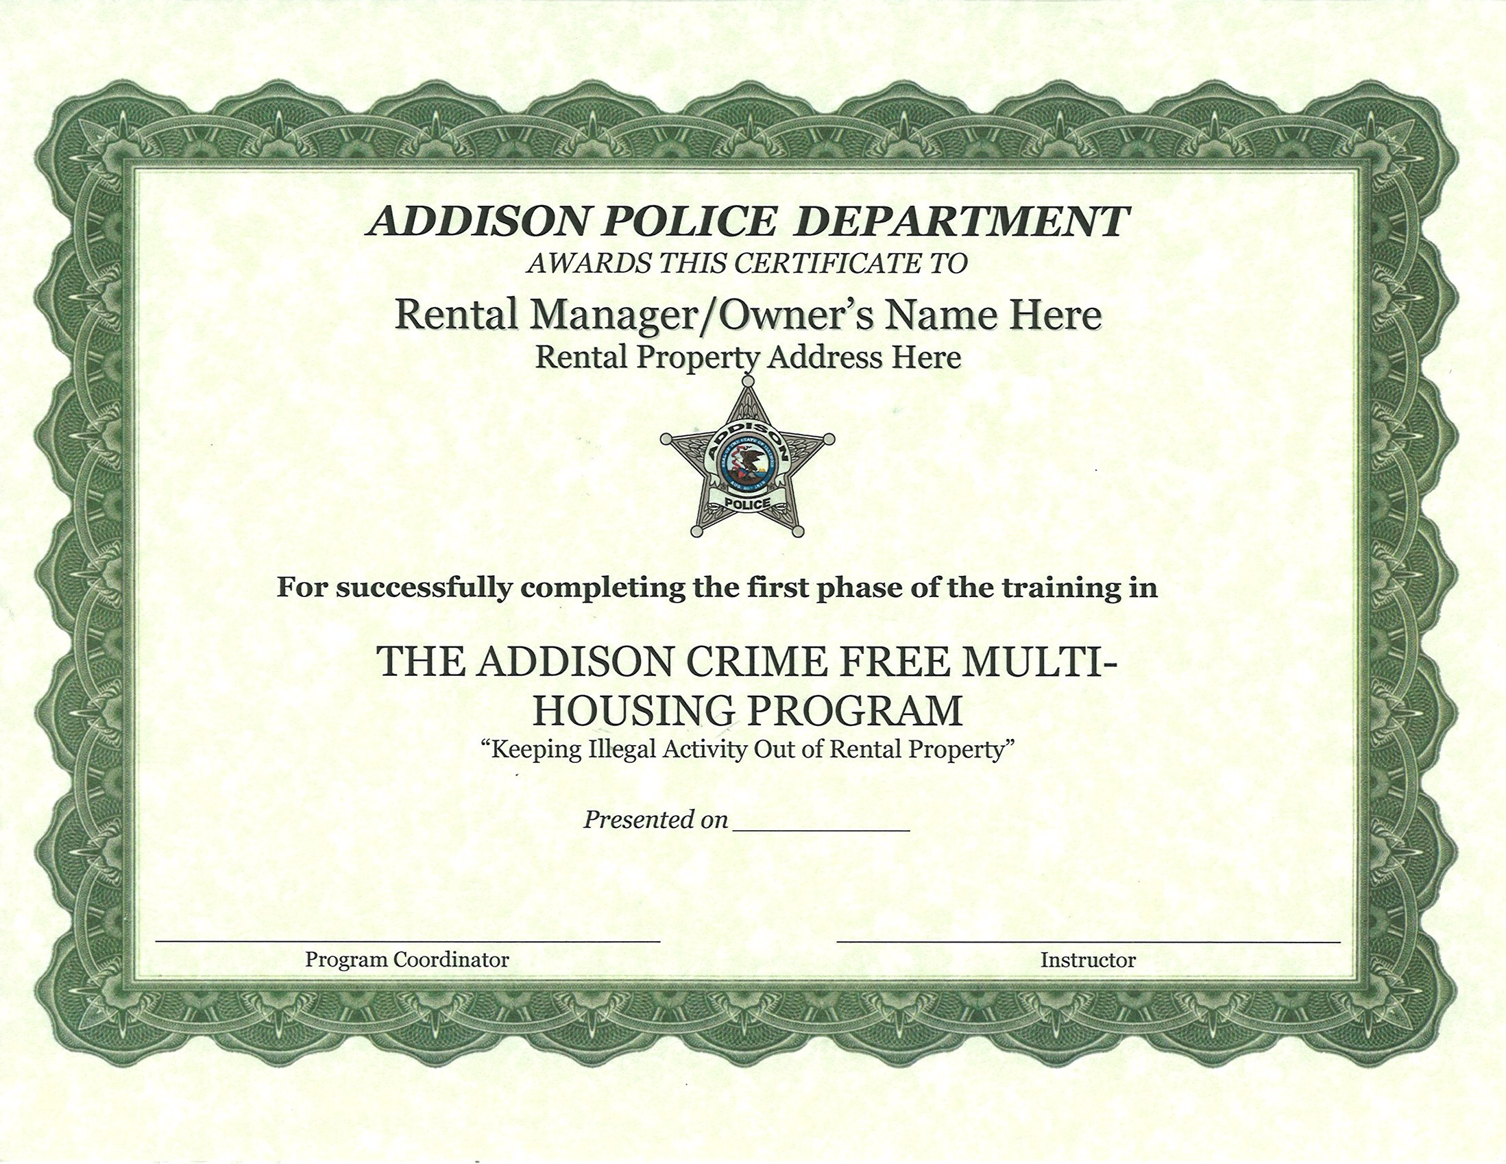

Slide 25
Ordinances / Requirements

Slide 26
OUR SAFETY NET ….
THE
CRIME FREE
LEASE ADDENDUM

Slide 28
Nuisance Abatement
Ordinance
It is unlawful for any property within the Village of Addison to become a Chronic Nuisance

Slide 29
Nuisance Abatement
Disorderly Conduct
Unlawful Use of Weapons
Mob Action
Discharge of a Firearm
Gambling
Poss., Manuf., or Delivery of a Controlled Substance
Public Indecency
Assault or Battery
Sexual Abuse
Prostitution

Slide 30
Nuisance Abatement
Criminal Damage to Property
Poss., Cultivation, Manuf., or Delivery of Cannabis
Illegal Consump. Or Poss. Of Alcohol by Minor
Criminal Housing Mgmt
Structure Unfit for Occupancy
Unsafe Structure
Unlawful Structure
Property Maintenance Code violations (after court complaint)
Violation of felony/Class A Misdemeanor

Slide 31
Nuisance Abatement
Letters

Slide 32
Nuisance Abatement
We have sent out 446 Nuisance Abatement letters to rental property owners since 2010, and currently have a 65% eviction / leaving rate.

Slide 33
Nuisance Abatement
151 letters were for Drug-Related Offenses. 76% of those tenants were evicted or left on their own

Slide 34
Nuisance Abatement
80 letters were for Felony-Related Offenses. 72% of those tenants were evicted or left on their own

Slide 35
Nuisance Abatement
114 letters were for Minor Offenses – 68% of those tenants were evicted or left on their own

Slide 36

Per Village of Addison Ordinance, the Nuisance Abatement Ordinance does not apply to domestic-related calls. These types of calls will not be used against the landlord or the tenant.

Slide 37
SAFE HOMES ACT
The “Safe Homes Act” is an Illinois law that allows victims of domestic or sexual violence to leave their rental housing early, prior to the end of their lease, in order to protect their physical safety and emotional well being. In certain circumstances, victims can also request an emergency lock change to keep the abuser out of the home.

Slide 38
Nuisance Abatement
Overall, all calls for service at properties that have received Nuisance Abatement letters have decreased by 54%

Slide 39
Who has the Power?
The police can arrest, but the offenders are usually released immediately!
They are not afraid of the police or the courts.

Slide 40
Who has the Power?
Only the landlord or their agent has the authority to remove the tenant permanently from the property.
We have more impact on them civilly than we do criminally.

Slide 41
“Rampaging Renter” Video

Slide 42


Slide 43
Tenant Screening

Slide 44
Background screening is not required, but it is the “norm”.
Better to be safe than sorry!

Slide 45
TOP REASONS TO SCREEN:
Provides useful information of the prospective tenant to help aid you in making sound decisions
Reduces likelihood of the criminal element living and operating in your building
Provides a level of comfort to existing tenants
Reduces insurance risks and legal exposure

Slide 46
Criminals Prefer Rentals
They are often very transitory in nature
If necessary, they can move away quickly
They want to BLEND into a larger crowd
Asset-Forfeiture Laws do not generally apply

Slide 47
Most Criminals look for:
The path of least resistance
The easy target
The unaware
The fearful

Slide 48
SINGLE UNIT
RENTAL OWNERS
CAN BE BIGGER TARGETS…..
No managers on site
Owner may not live in town
Owner may not check property often

Slide 49
If we DON’T rent to criminals:
We keep them out of our communities
We cut crime in rental properties
We cut crime village-wide

Slide 50
The BEST Way to
Prevent Crime?
Stop it at the Front Door!

Slide 51
The WORST time to ‘screen’ your residents?
DURING THE EVICTION PROCESS!

Slide 52
Consider An Application ‘Interview’
- Startles the Applicant
- Empowers the Landlord

Slide 53
Use The Most Thorough Process Possible To Screen Prospective Residents
APPLICANT SCREENING

Slide 54
FEDERAL FAIR HOUSING LAWS PROTECT:
Race
Color
Gender
Religion
National Origin
Familial Status
Disability(ADA)

Slide 55
Have WRITTEN and clearly POSTED policies.
Apply them EQUALLY to All Prospective Residents.

Slide 56
Your Policies
Application Criteria
Grounds for Denial
Community Rules
Background Check Waiver Form

Slide 57
The Rental Application
Should Ask About:
Criminal History
Felonies AND Misdemeanors!
Plea Bargains
Supervision/
  Probation/Parole
About Current Criminal Activity
Illegal Drug Use

Slide 58
The Crime Free
Lease Addendum
Should be presented BEFORE they fill out the application
Should be presented the same way to all prospective renters

Slide 59



RED FLAGS
“I need to move in tomorrow.”
“I will give you six months’ rent in cash in advance.”

Slide 60
How To Verify Information:
Don’t take Shortcuts or be Rushed
Compare ID to Information Given
Identify PREVIOUS Landlord”S”
FOIA Form from Previous Towns

Slide 61
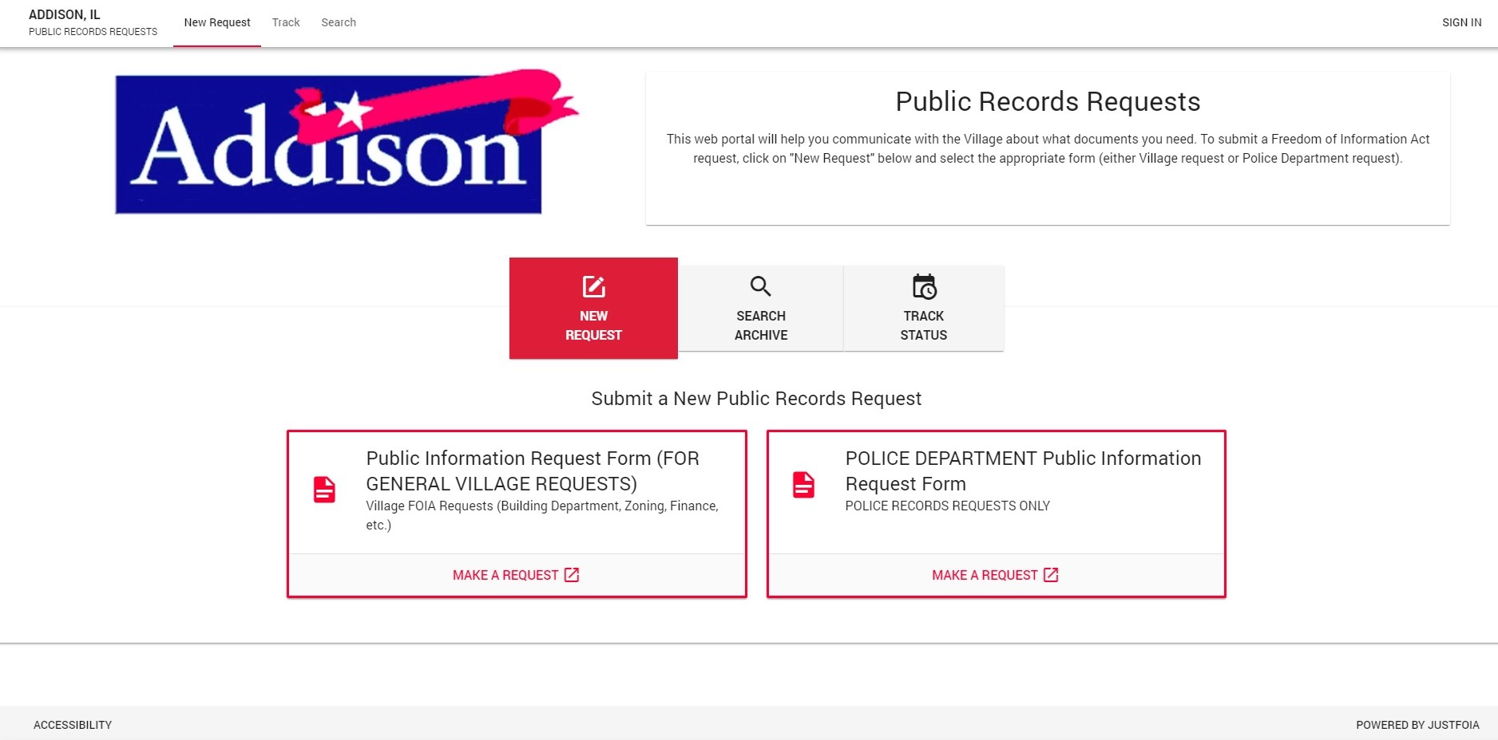

Slide 62
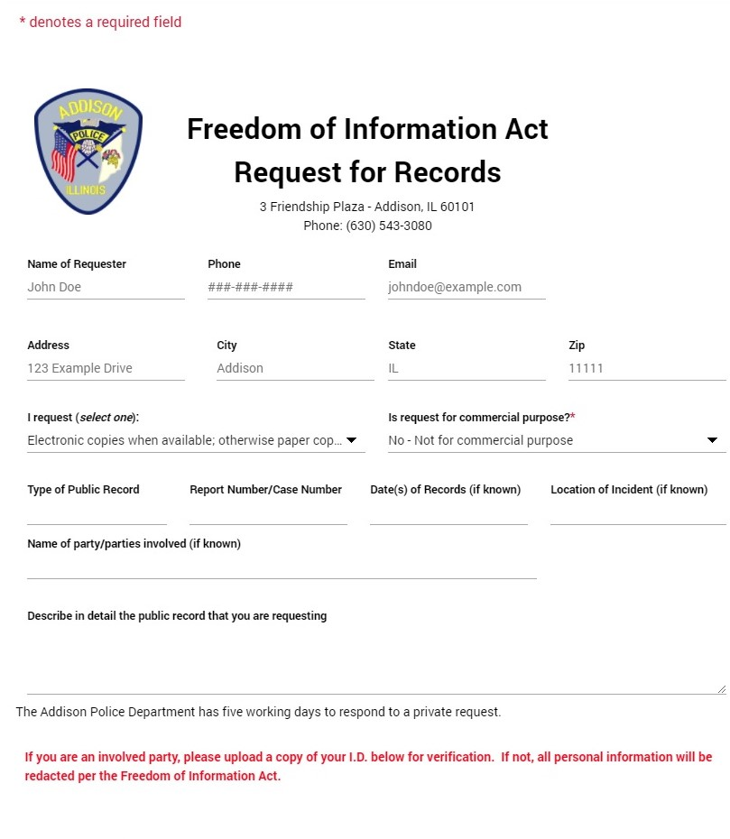

Slide 63
How To Verify Information:
Have a STANDARD List of Questions
Are Co-Signers needed
Verify Income Sources
Run Credit and Criminal Check

Slide 64
Application Fees
Have a “reasonable” application fee
You should NOT have to cover the screening costs
Thorough resident screening can be done for about $50
Screen EVERYBODY 18-yoa and above

Slide 65
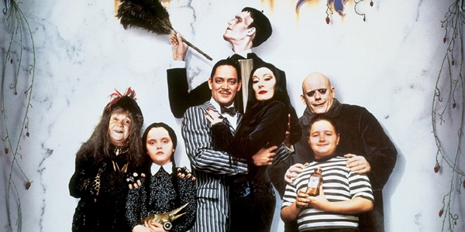
MAKE SURE TO MEET THE
WHOLE FAMILY ….

Slide 66
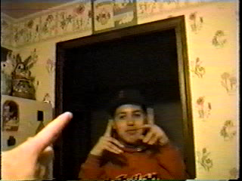
“The kids want to have a little get together …”

Slide 67
Hear no evil …
See no evil …
No problems … right?
  Consider walking or visiting the property regularly
  Consider including “routine inspections” in your lease

Slide 68
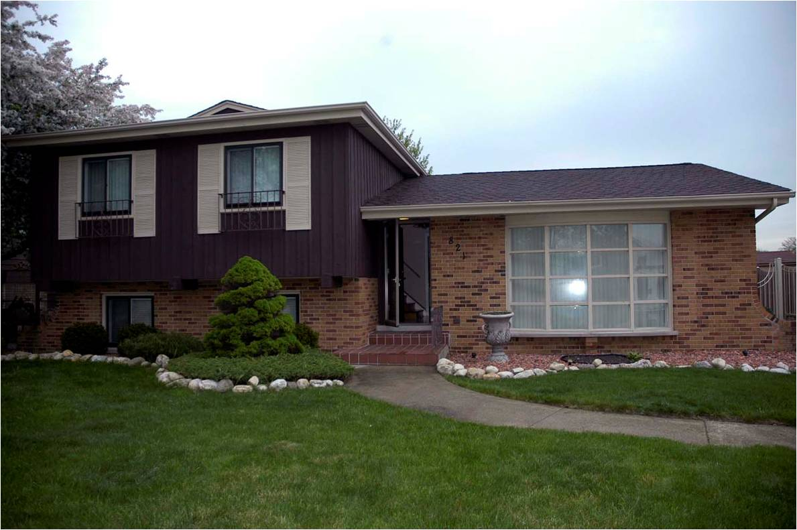

Slide 69
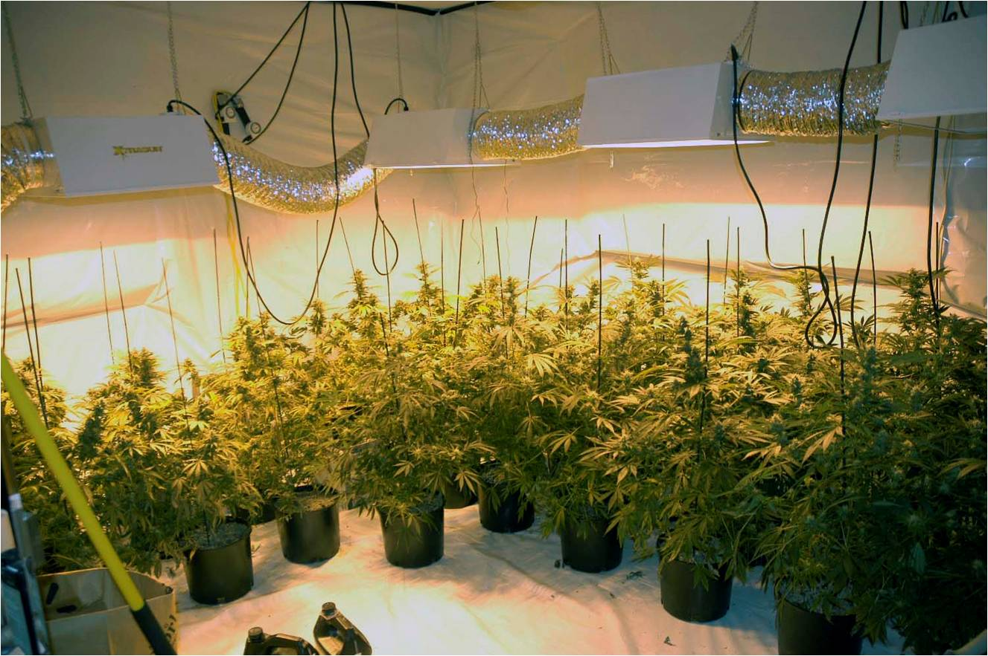

Slide 70
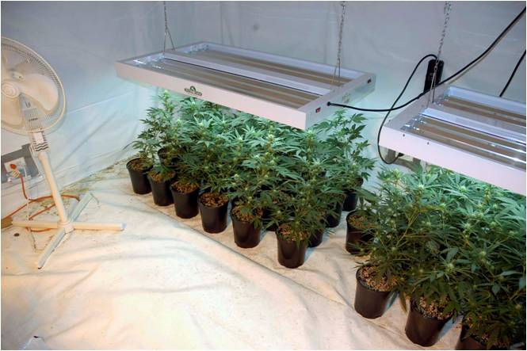
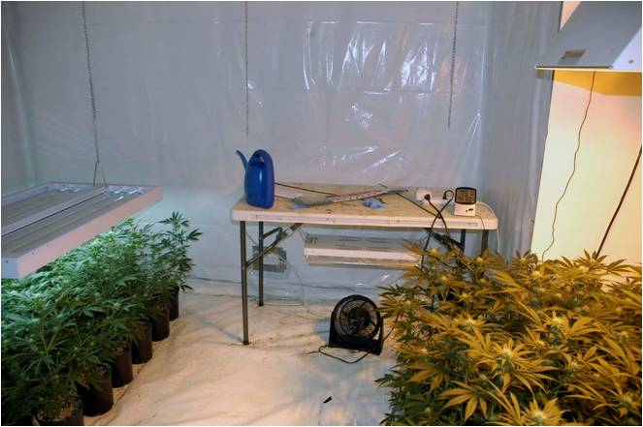
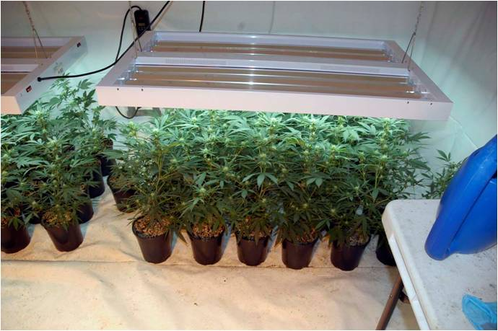
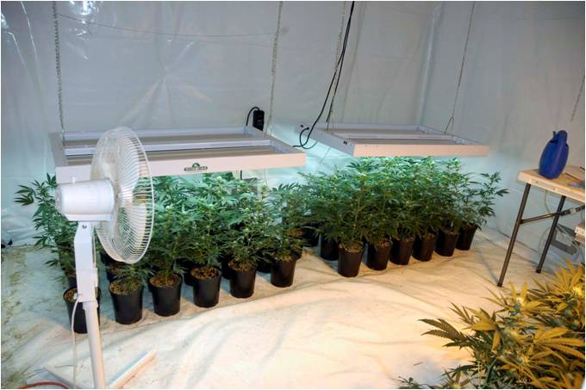

Slide 71
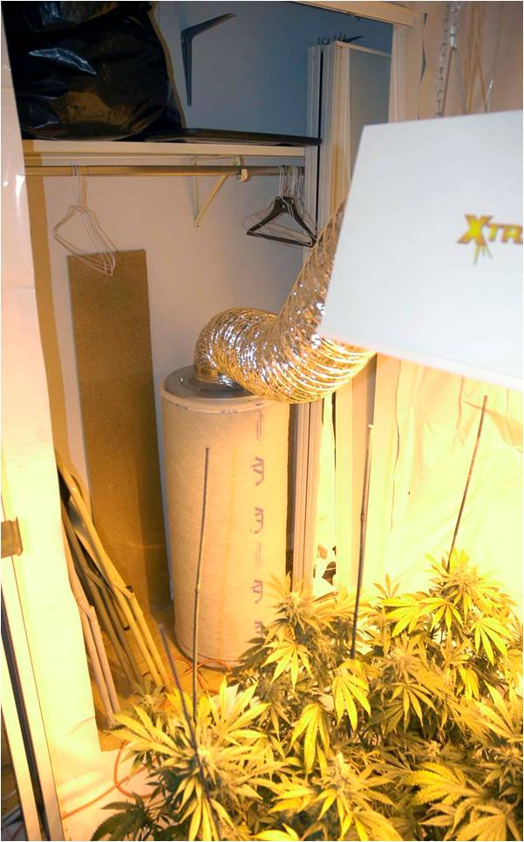
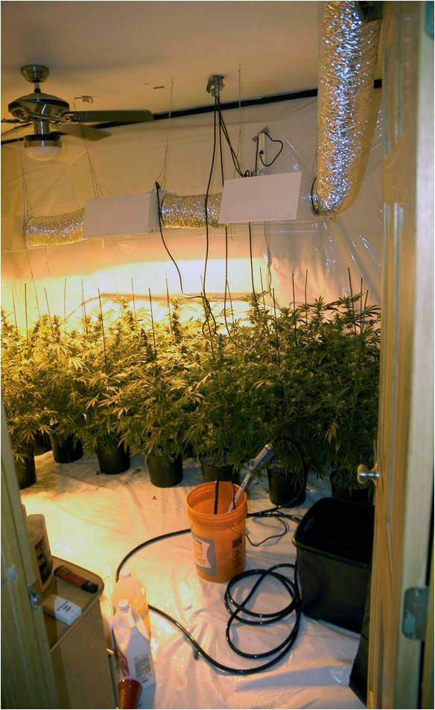

Slide 72
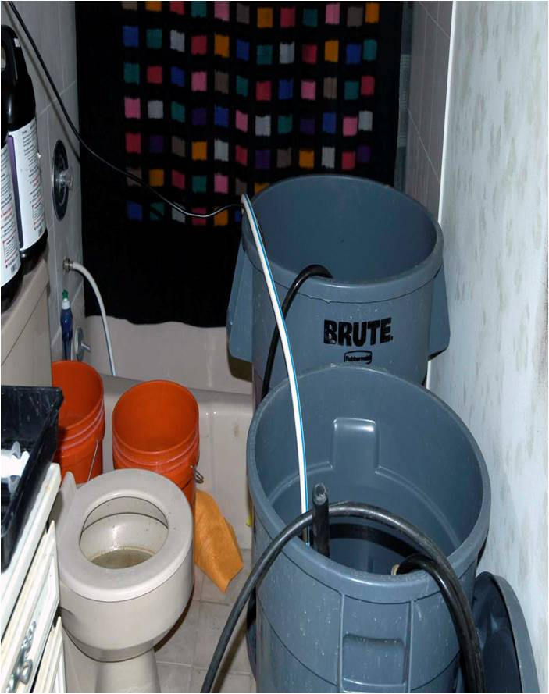

Slide 73
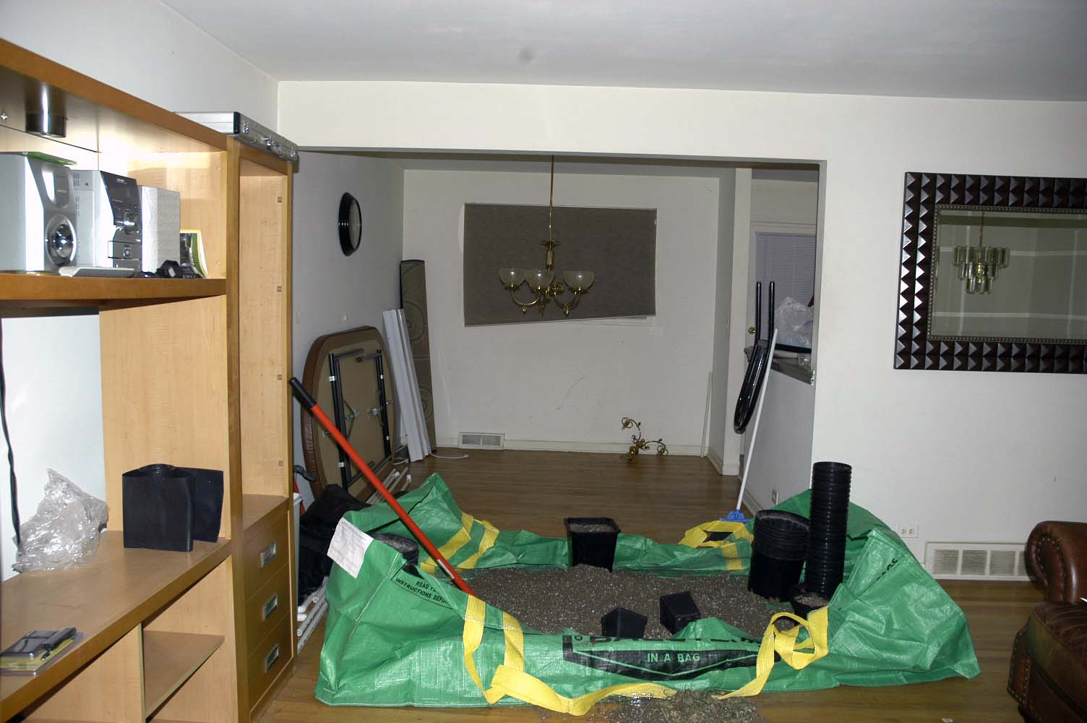

Slide 74

MEDICAL MARIJUANA
State Law vs. Federal Law
Federal Fair Housing Laws
Can you deny a potential renter who holds a medical marijuana card?
Must you allow the use of medical marijuana on the property? In the unit?

Slide 75
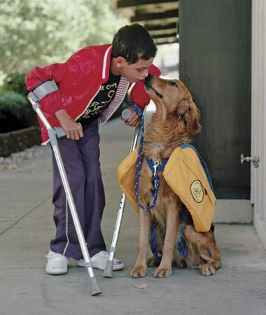
SERVICE ANIMALS

Slide 76
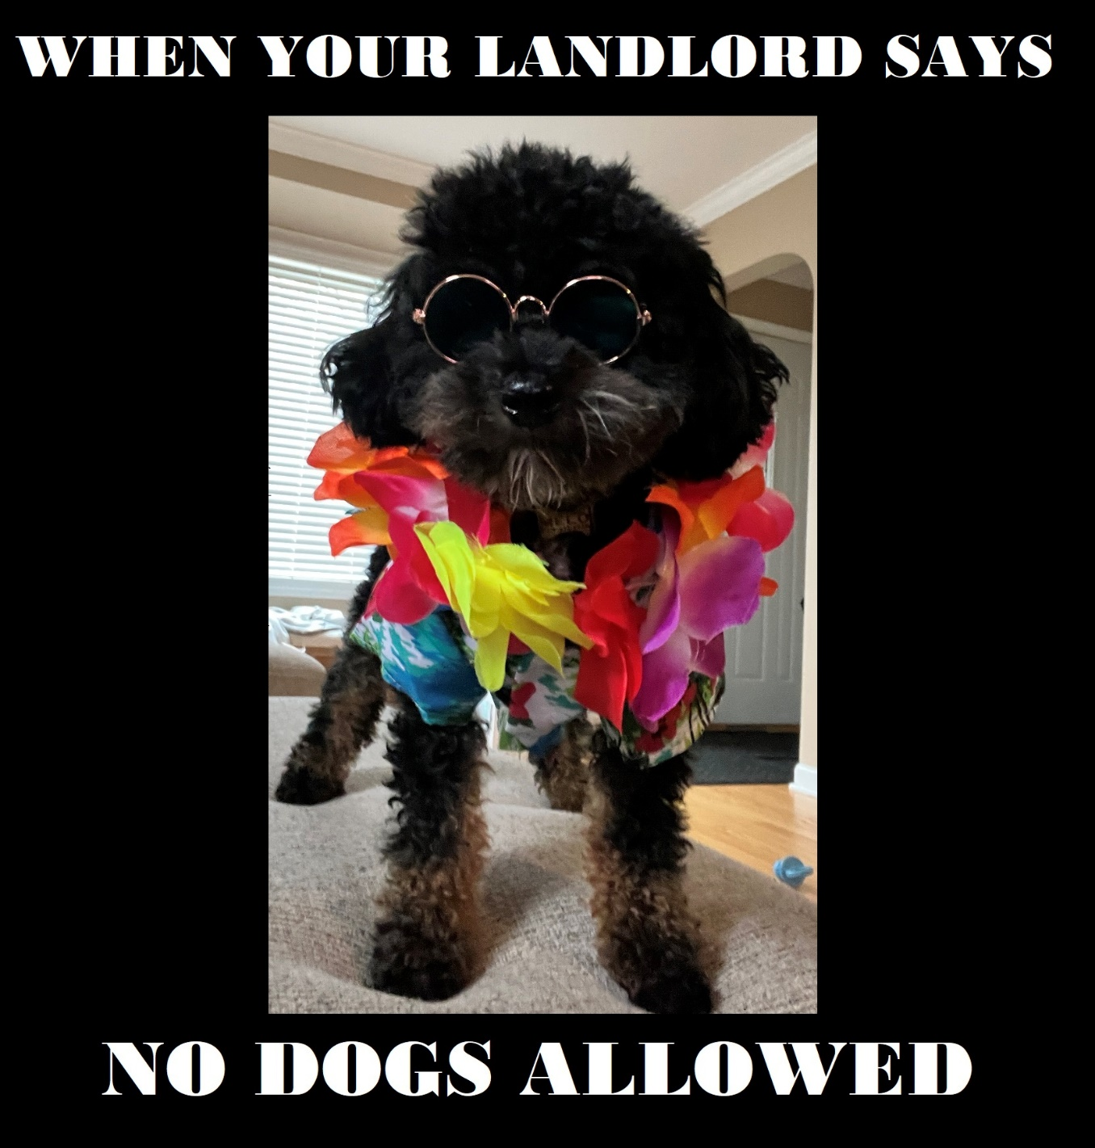

Slide 77
Screening Services

Slide 78
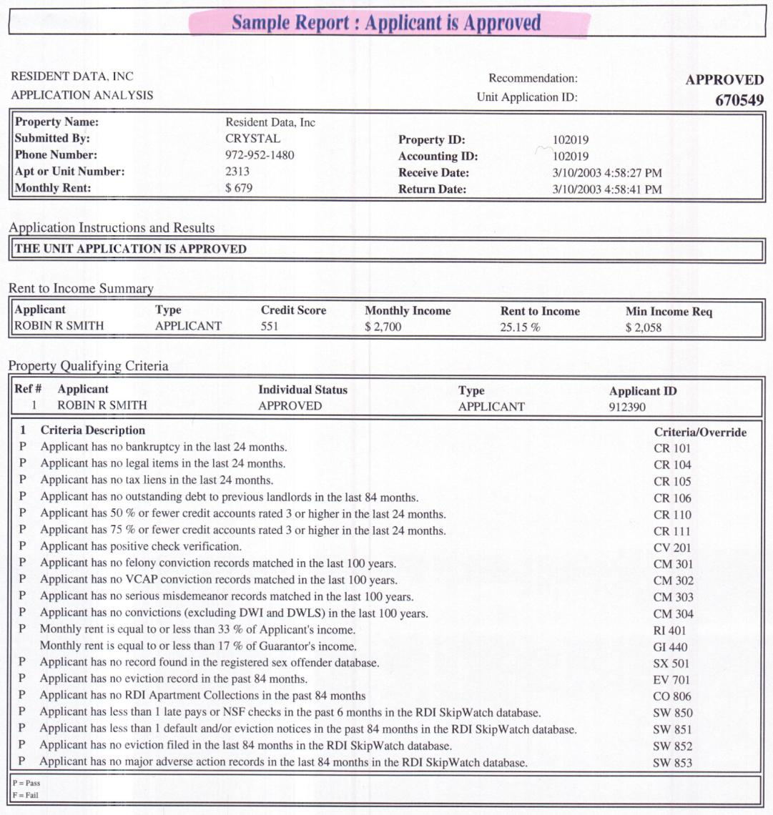

Slide 79
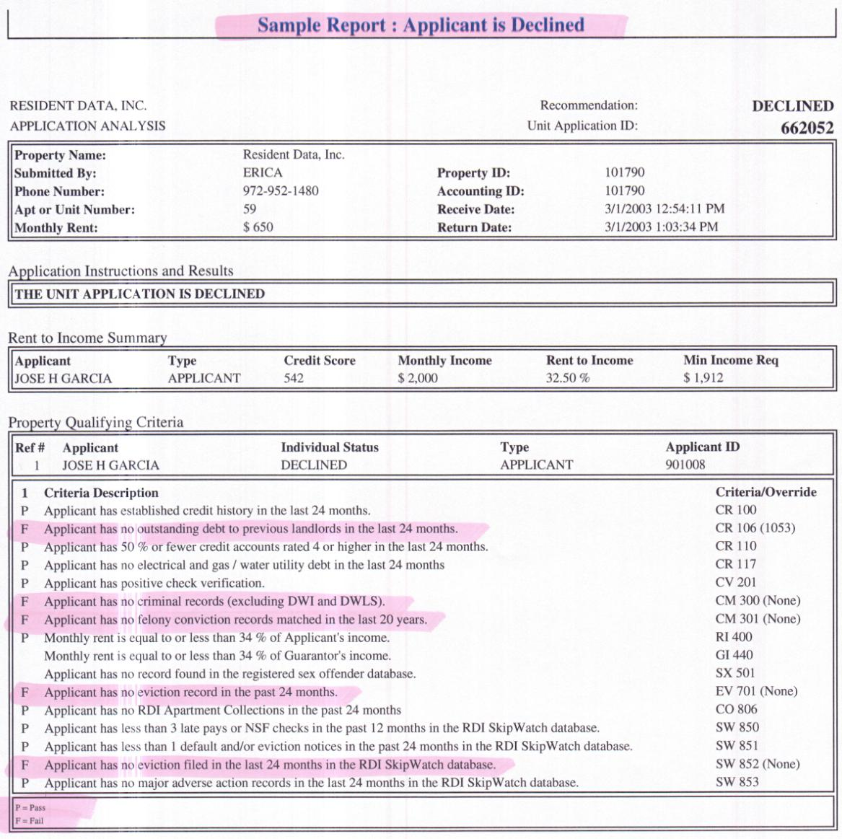

Slide 80
Refusing An Application:
Deny the “APPLICATION”
Don’t Defend The Facts
Just Listen
Be Empathetic

Slide 81
Refusing An Application:
Refer to a Higher Authority
(company policy)
Keep it brief
Refer to Screening Agency

Slide 82
MOST PROPERTY MANAGERS AGREE:
Plan your words VERY CAREFULLY-- Most discrimination suits are filed when the manager said too much.

Slide 83

Foreseeability
Knew about (or SHOULD
have known about)
Lack of care
Standards and practice

Slide 84
CRIMINAL HOUSING MANAGEMENT
720 ILCS 5/12-5.1
A person commits the offense of criminal housing management when, having personal management or control of residential real estate, whether as a legal or equitable owner or as a managing agent or otherwise, he recklessly permits the physical condition or facilities of the residential real estate to become or remain in any condition which endangers the health or safety of any person.

Slide 85
LANDLORD’S RESPONSIBILITIES TO THEIR TENANTS
Responsibility to Maintain a Safe Environment
- Tenant expects their home to be safe
- Ensure all doors and windows have working locks
- Make sure no one else has a key to the apartment
- Do not allow unsupervised repairmen inside
- Make sure outdoor areas are well lit and clean
Maintain a Clean Environment
Respond to Repair Requests Promptly
Advise your tenants to purchase renter’s insurance

Slide 86
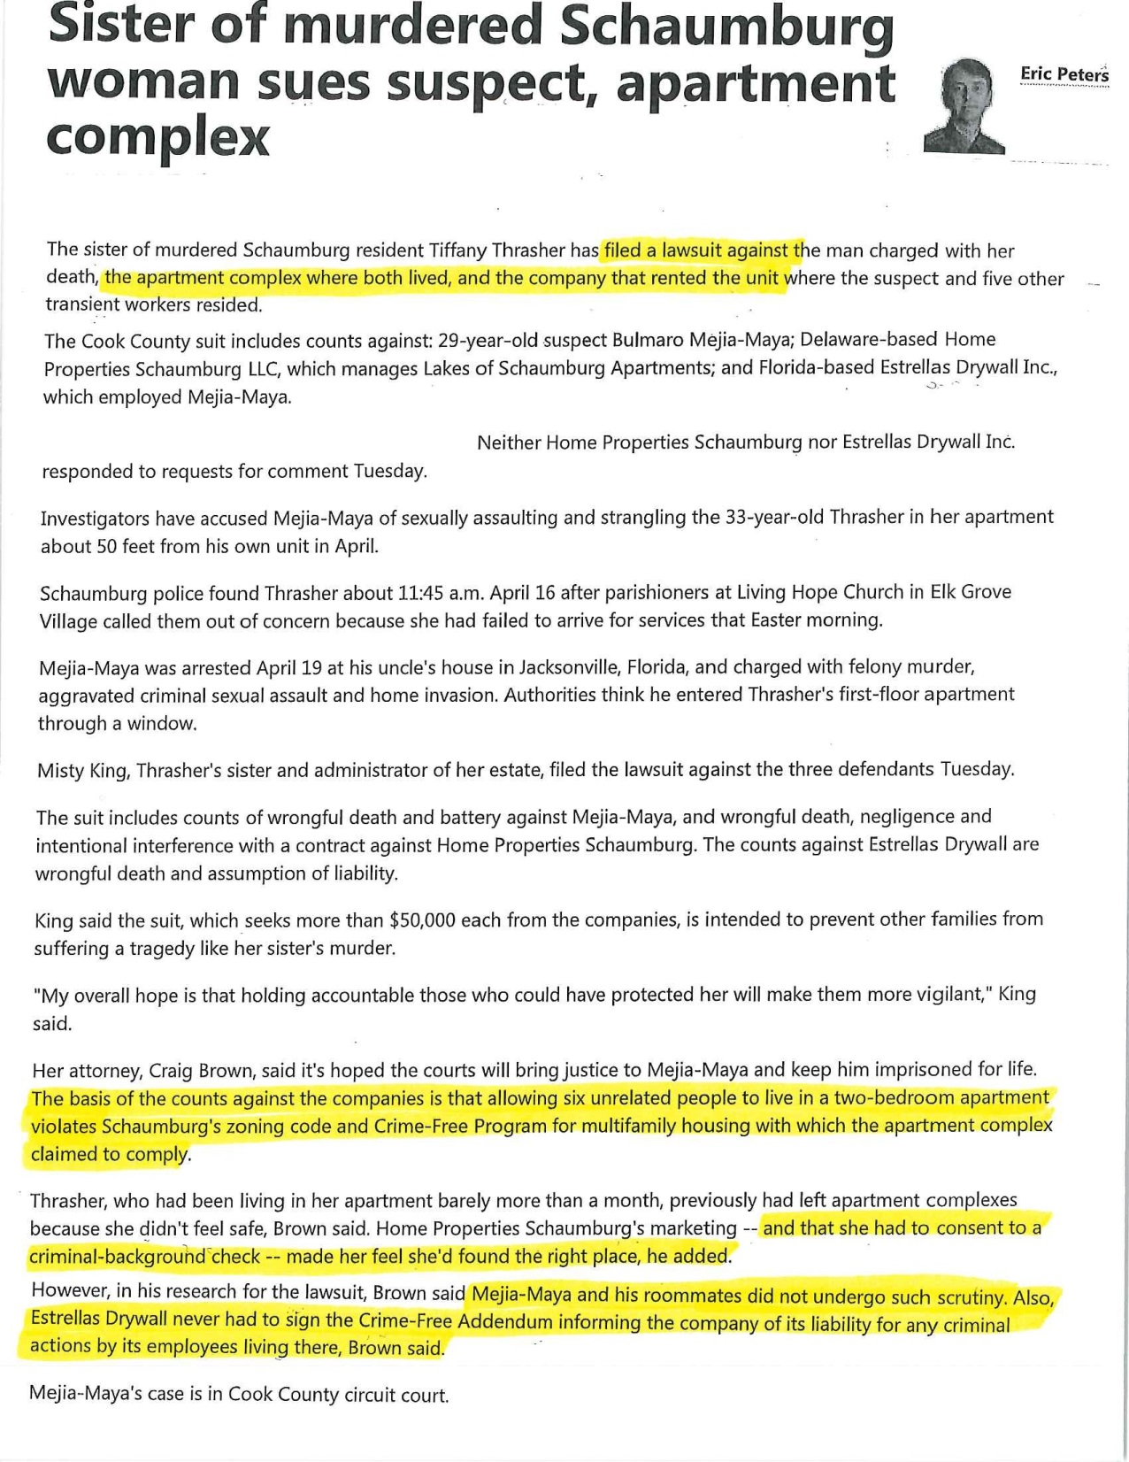

Slide 87
REGISTERED
SEX OFFENDERS
IN ADDISON
36 Registered Sex
Offenders live in
Addison
28 live in Rental Properties

Slide 88
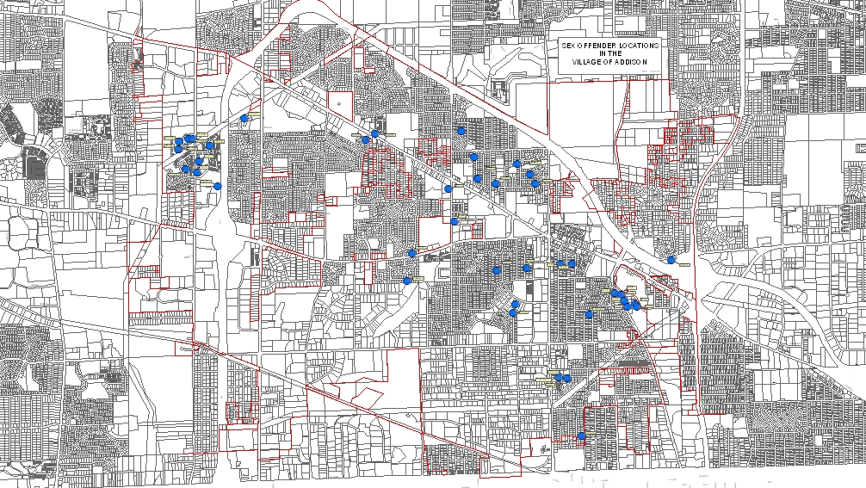
SEX OFFENDERS LIVING IN ADDISON

Slide 89
ADDISON POLICE DEPARTMENT
COMMUNITY RESPONSE UNIT

Slide 90
Community Response Unit
Created to address issues that arise in the community –
Ranging from gang and narcotics crimes to tenant issues and quality-of-life issues.

Slide 91
Community Response Unit
Works closely with Community Development to address quality-of-life issues within the village
Village Code Violations
Follows up on Nuisance Abatement issues
Vacant Home Checks
Apartment Parking Lot Light Checks
Street Light Checks

Slide 92
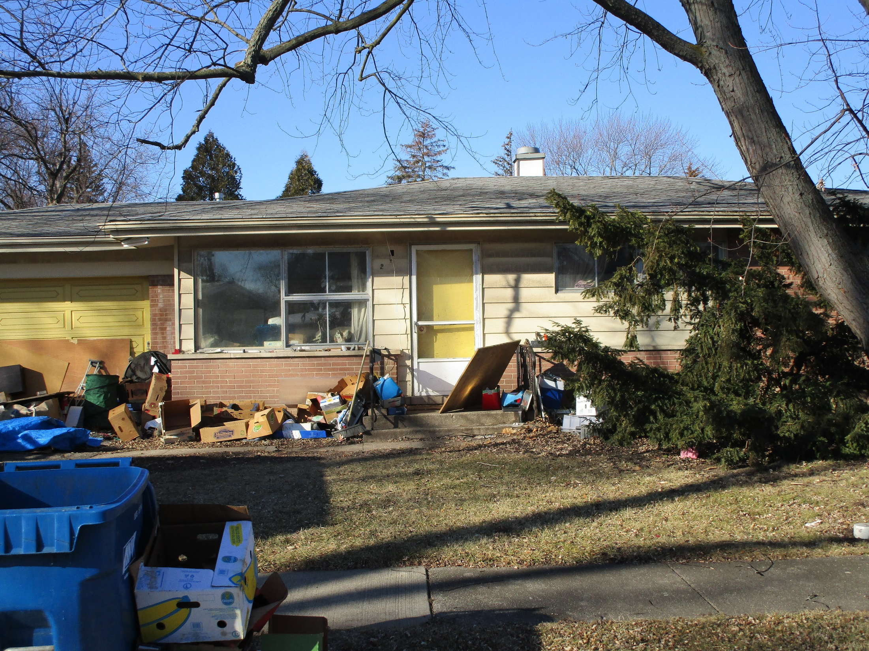

Slide 93
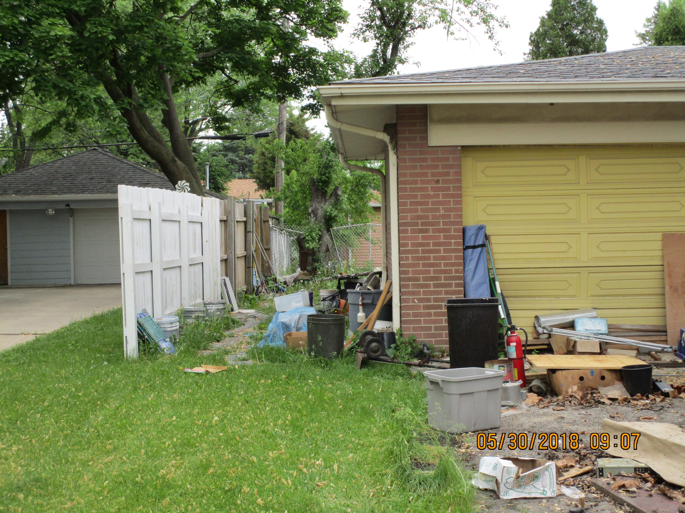

Slide 94
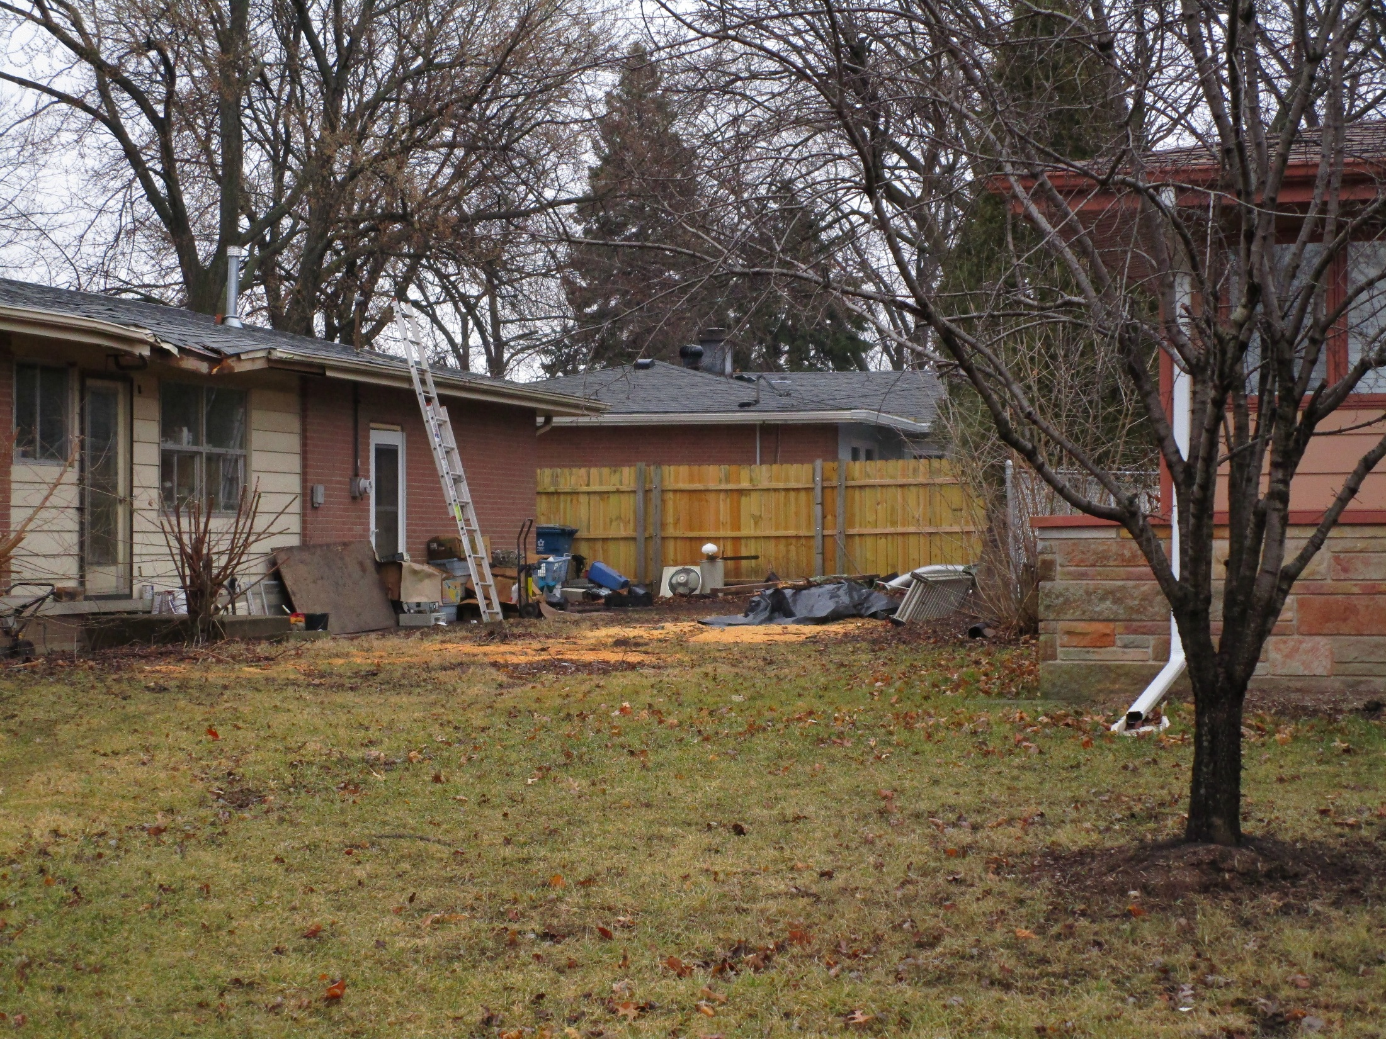

Slide 95
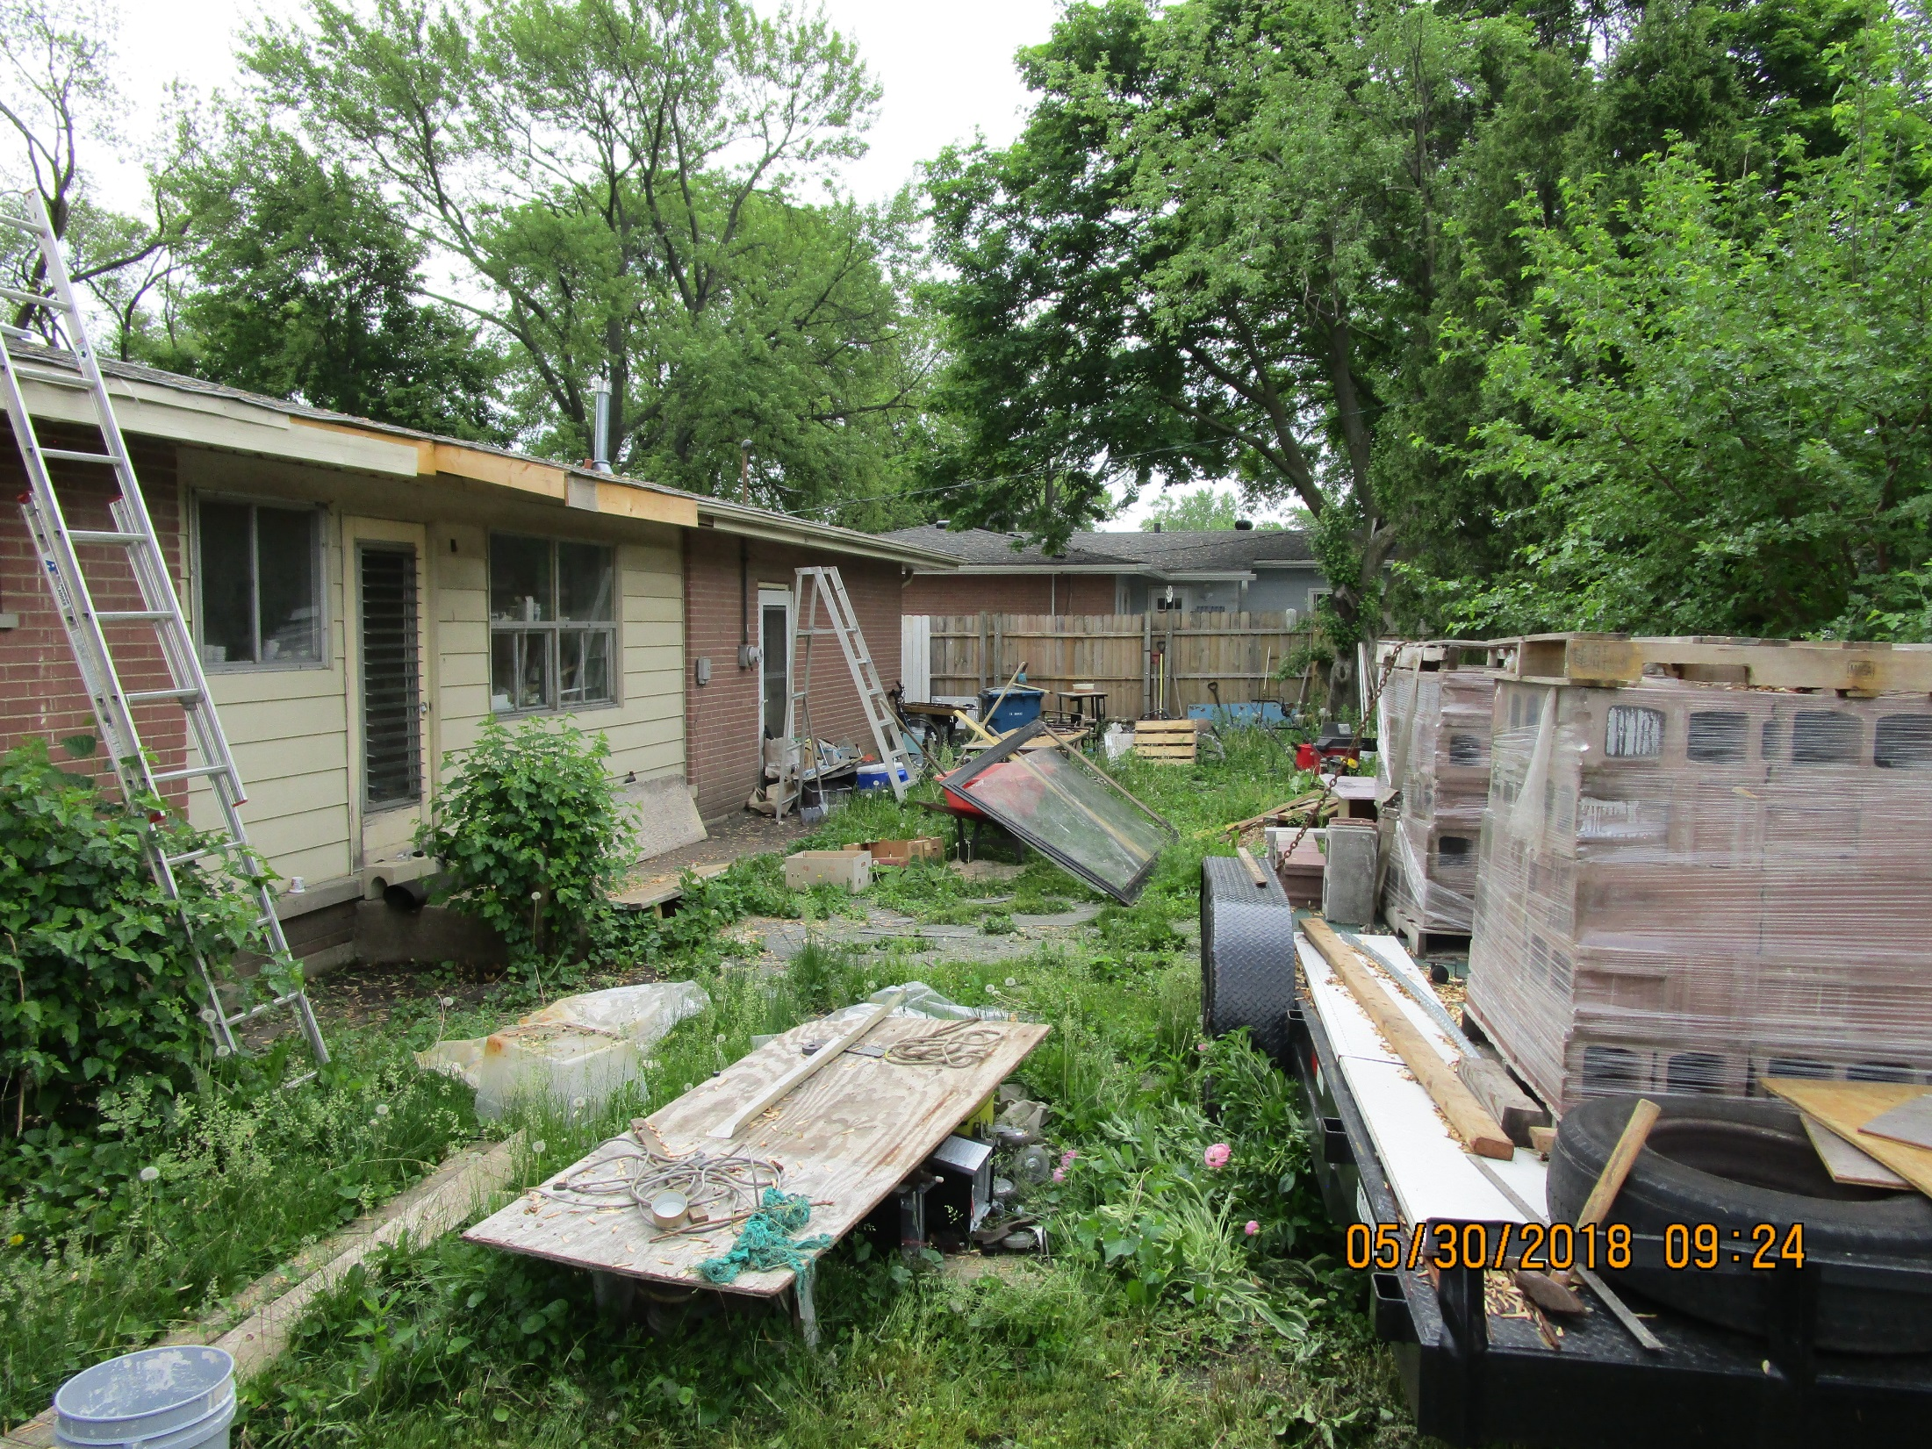

Slide 96
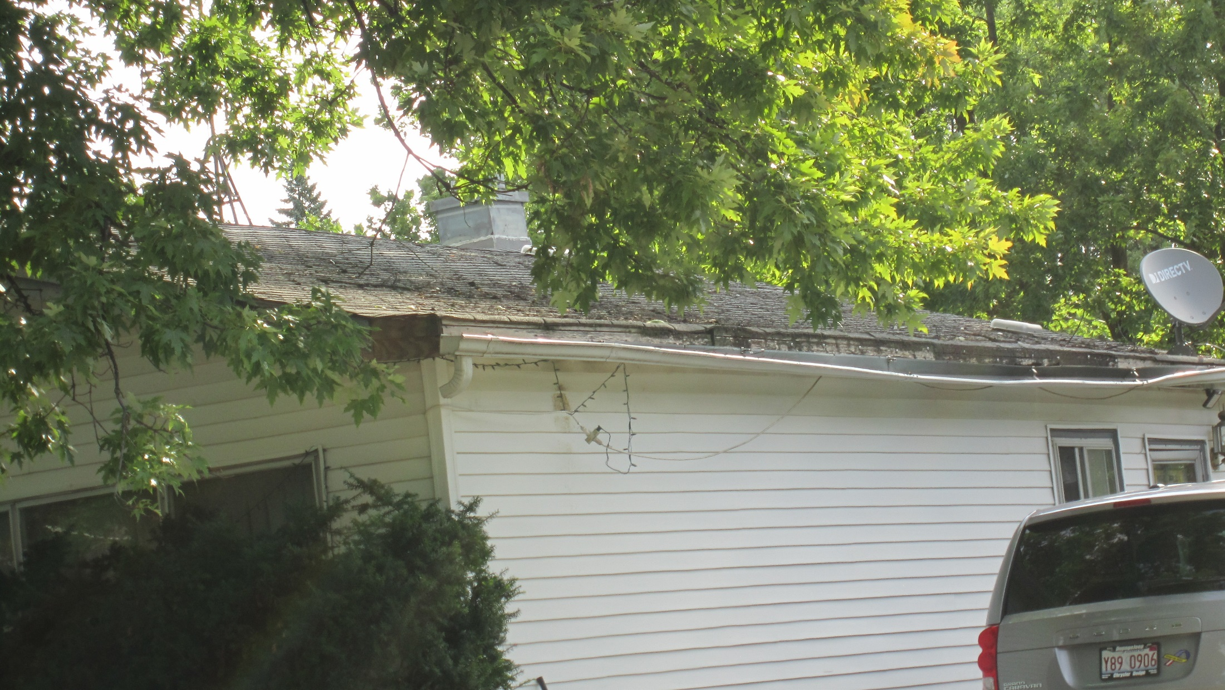

Slide 97
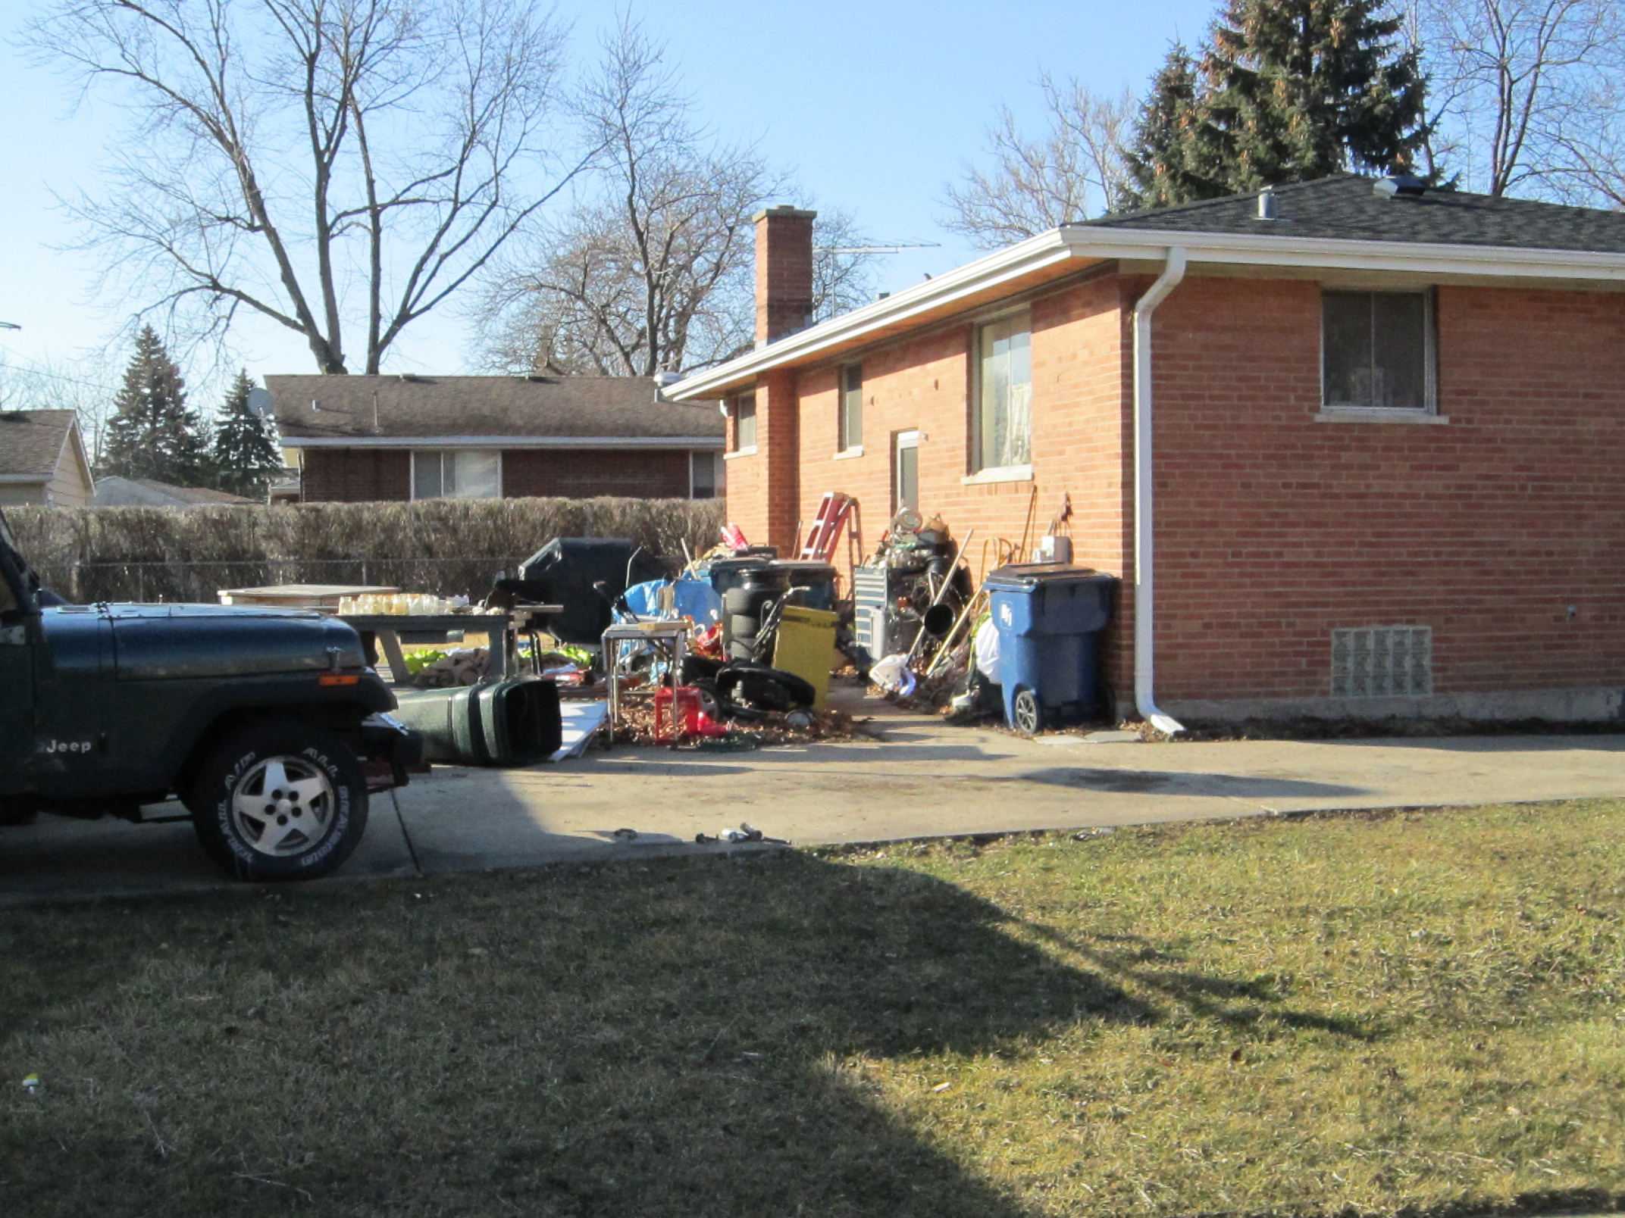

Slide 98
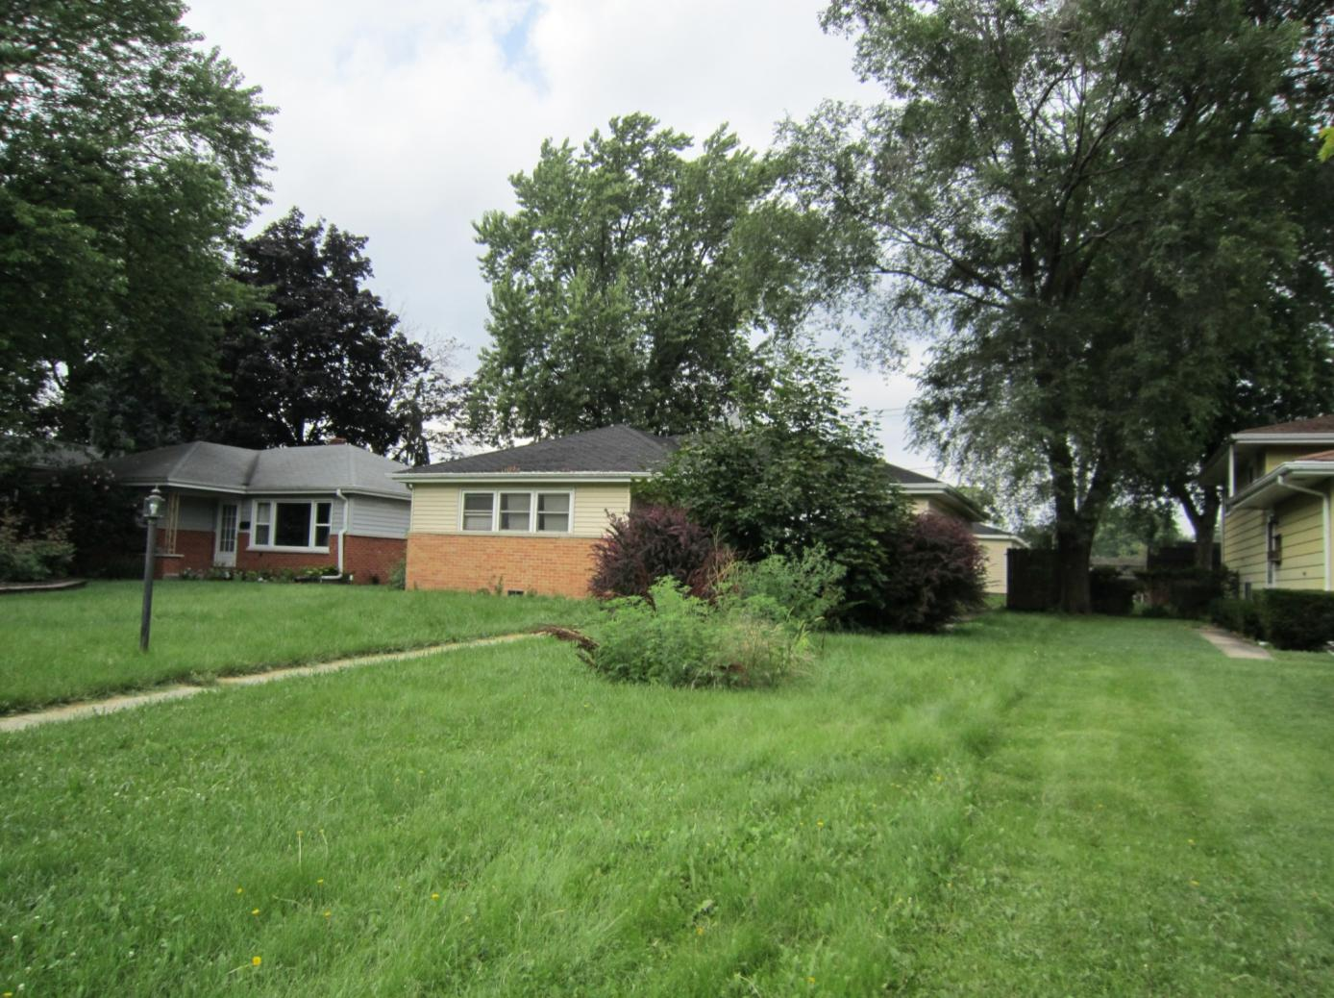


Slide 99
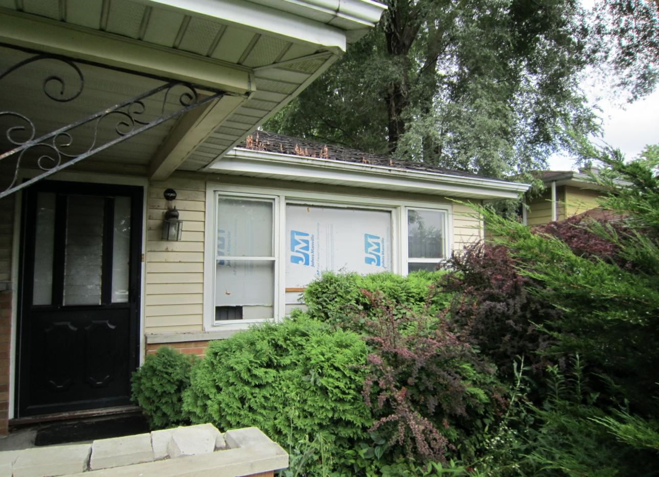

Slide 100
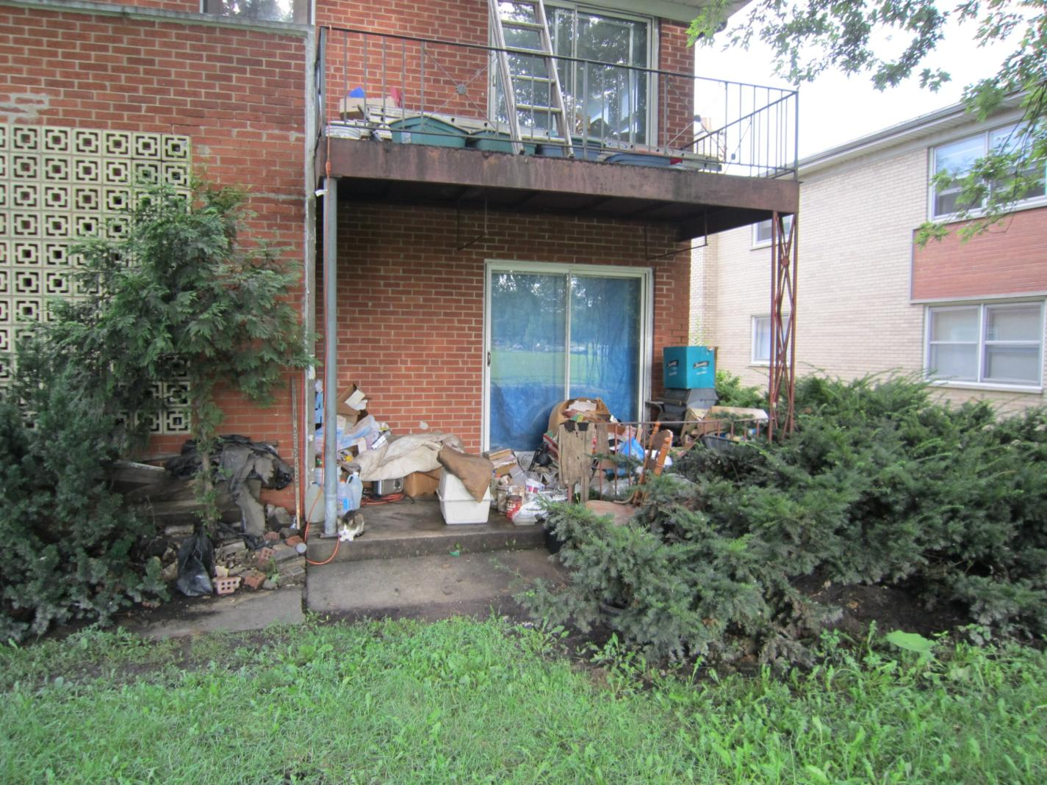

Slide 101
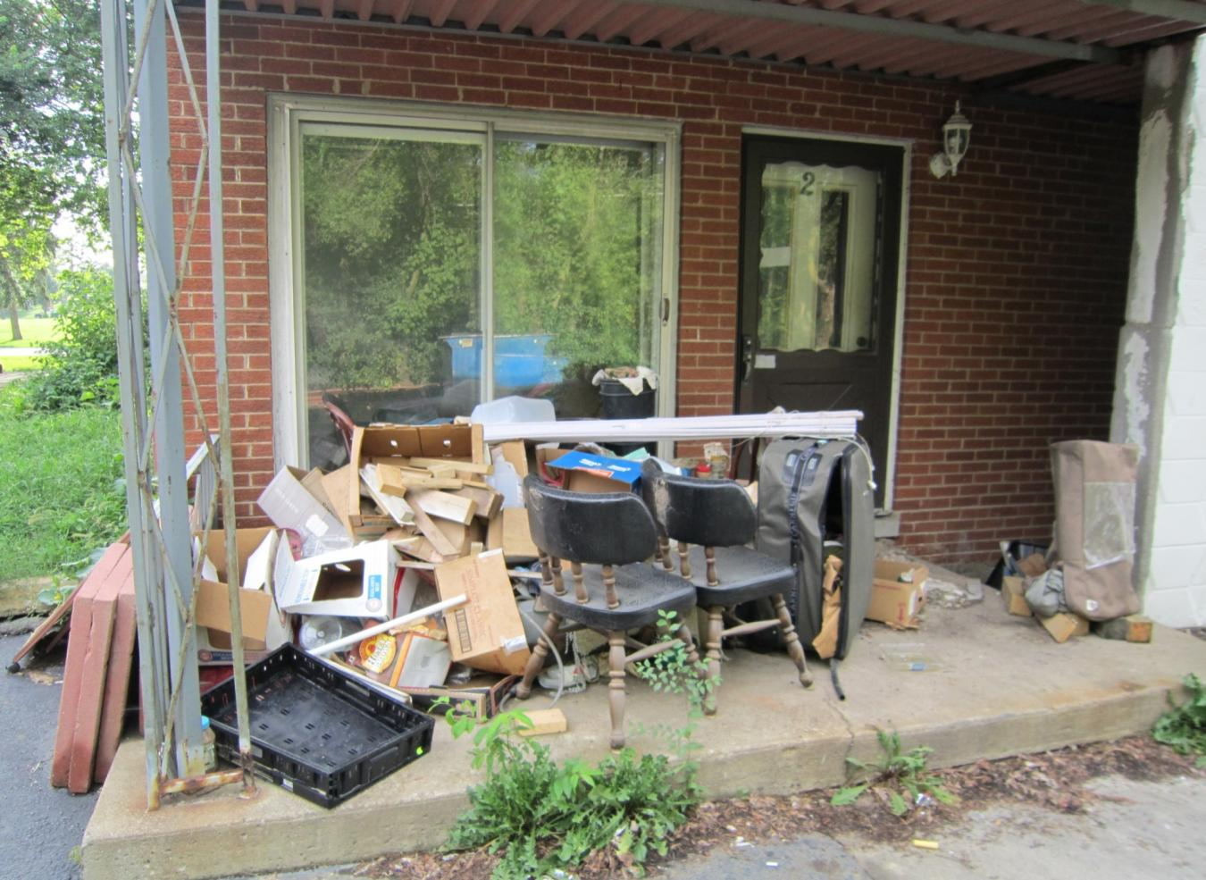

Slide 102
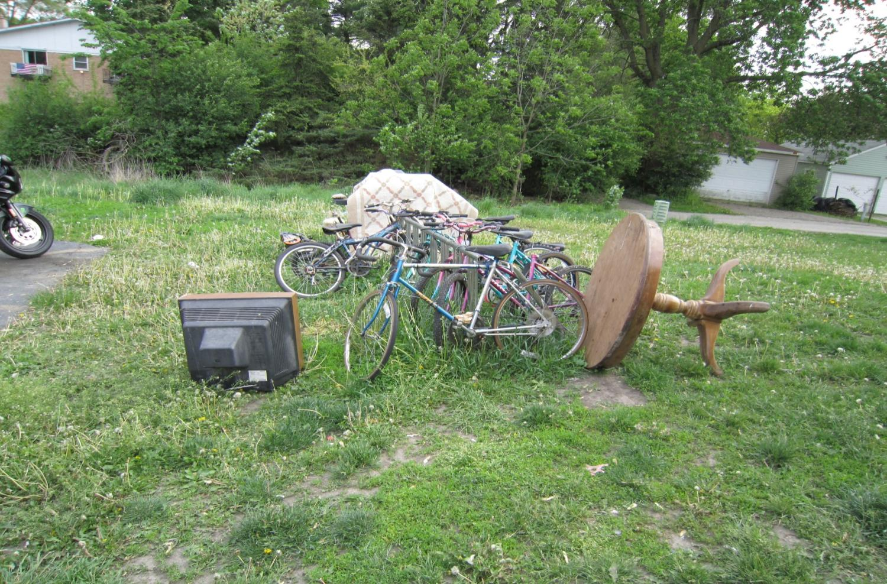

Slide 103
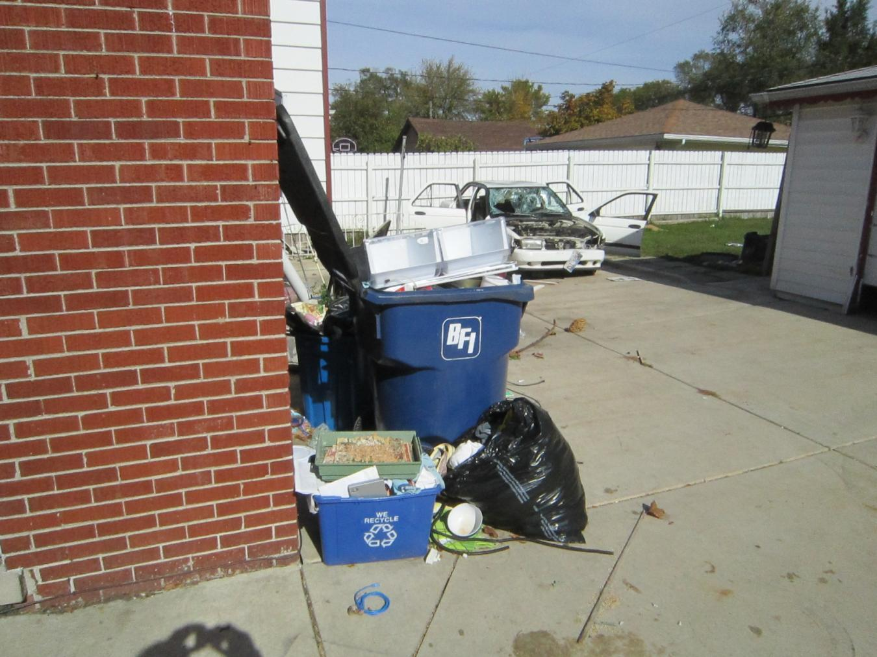

Slide 104


Slide 105
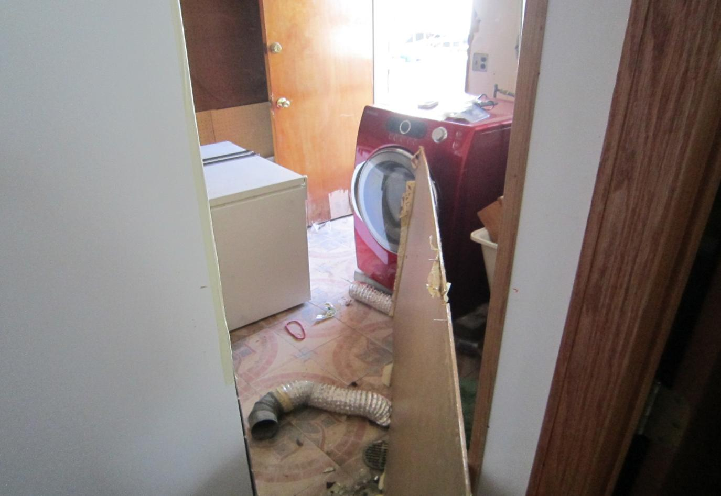

Slide 106
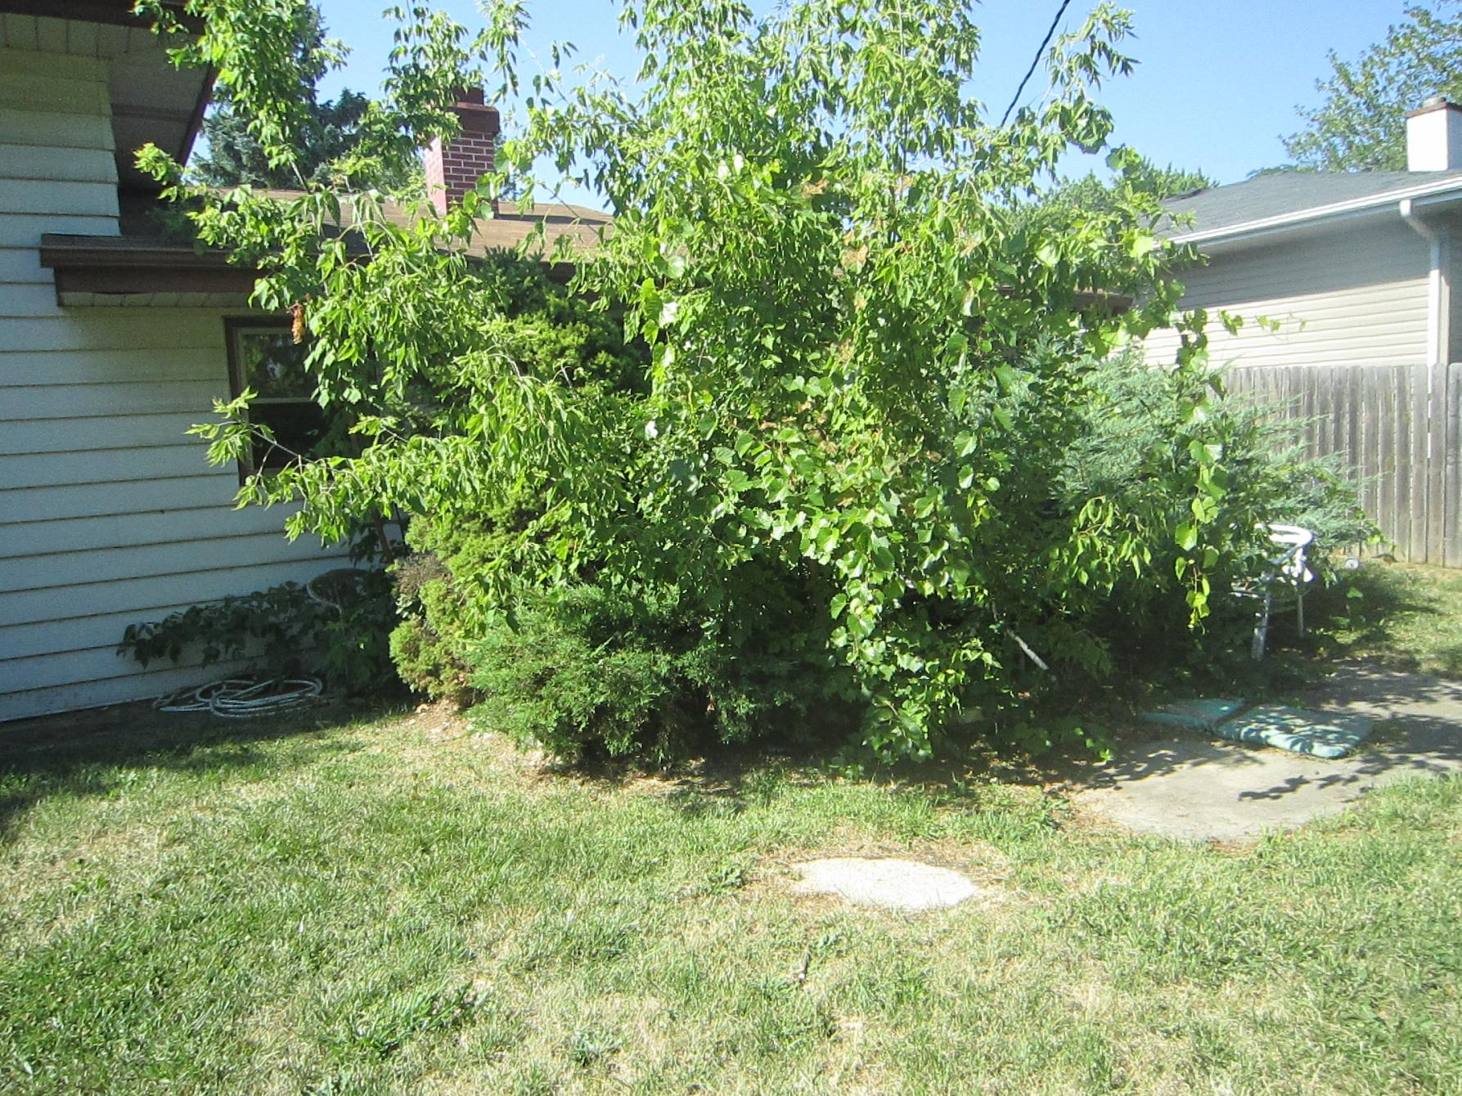

Slide 107
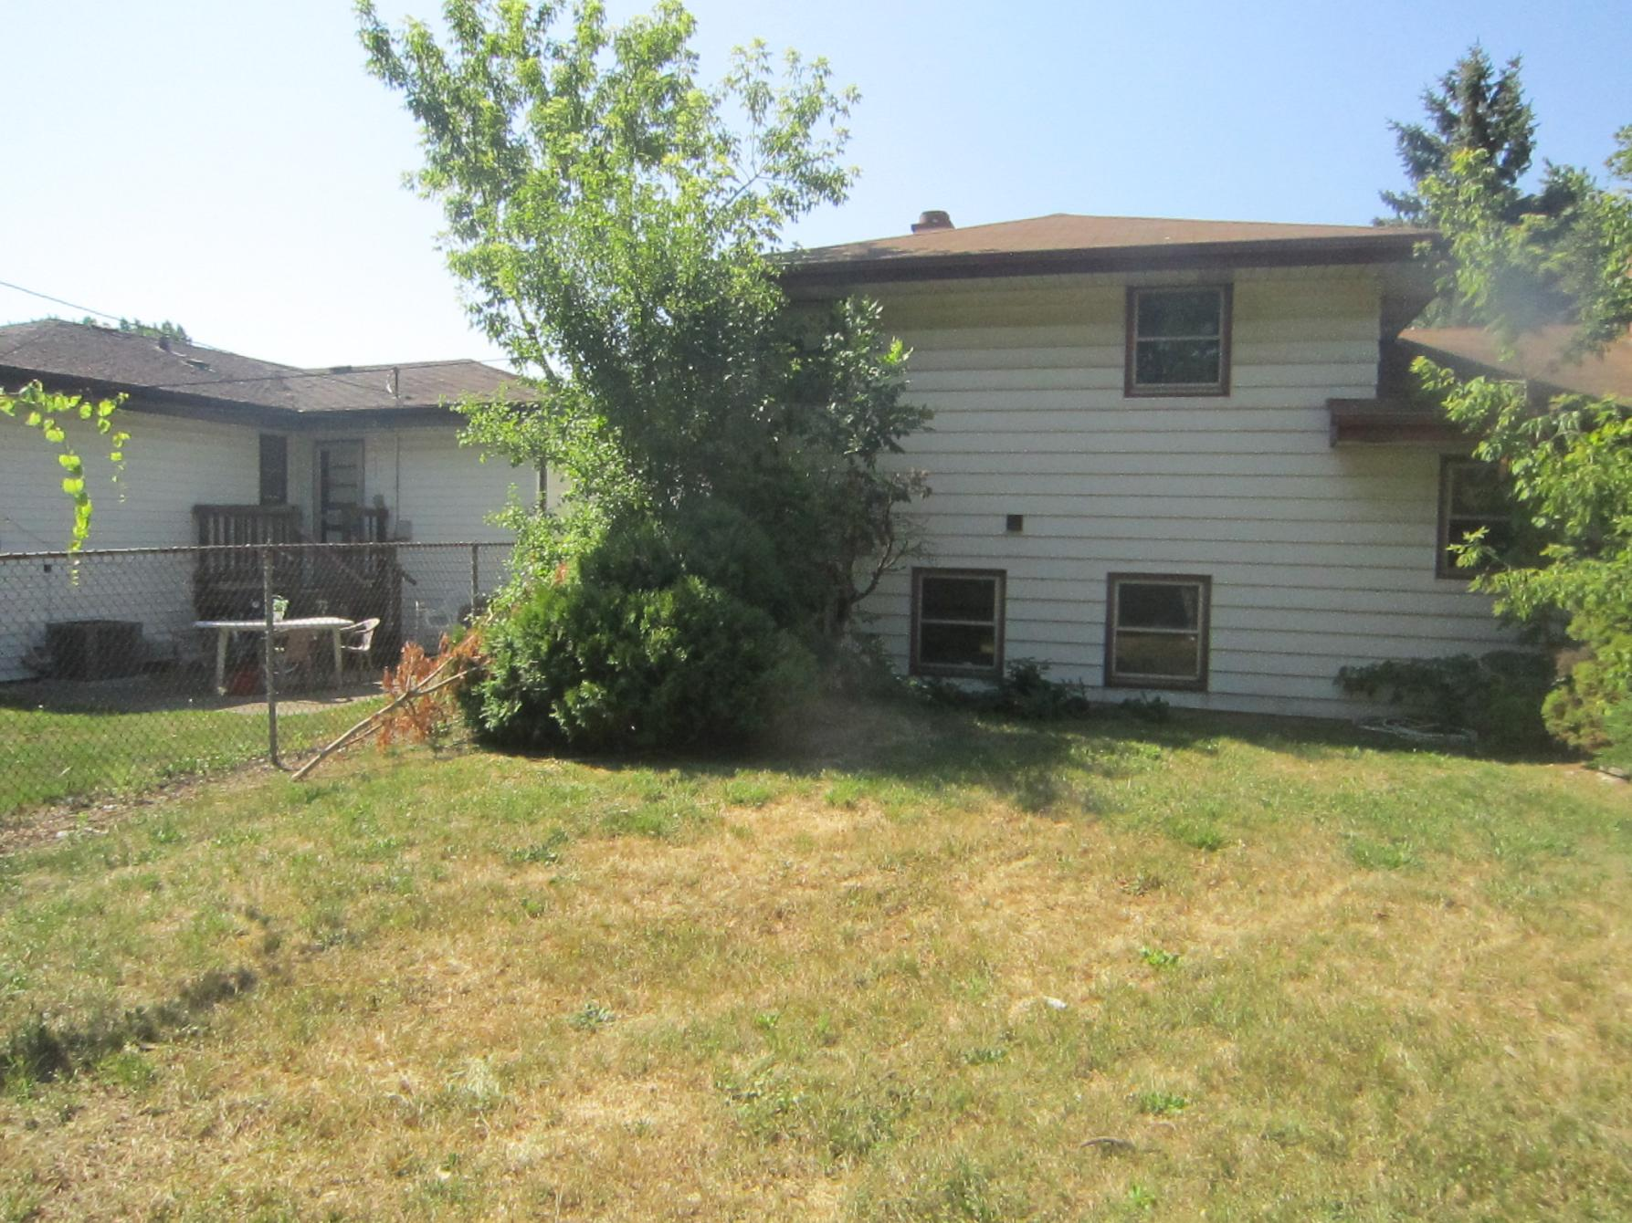

Slide 108
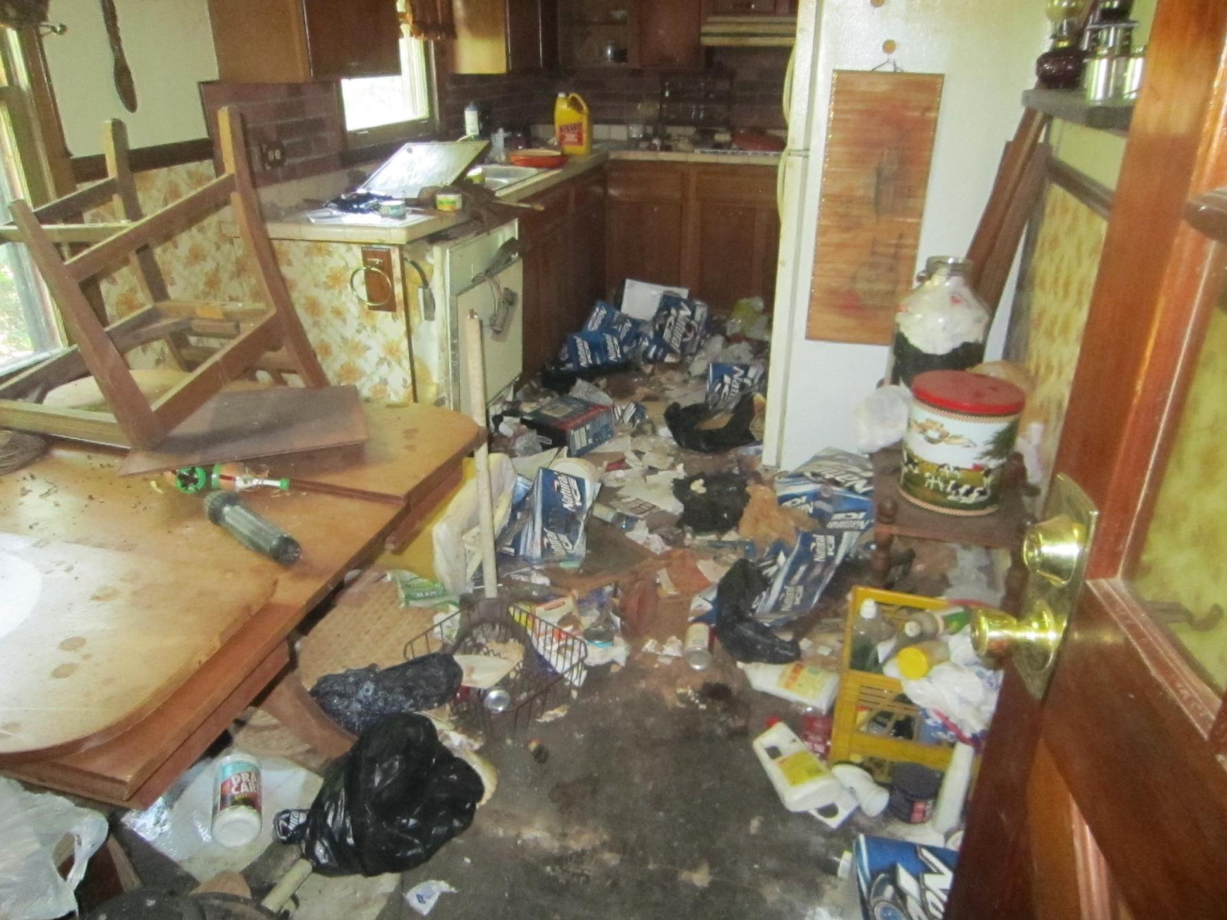

Slide 109
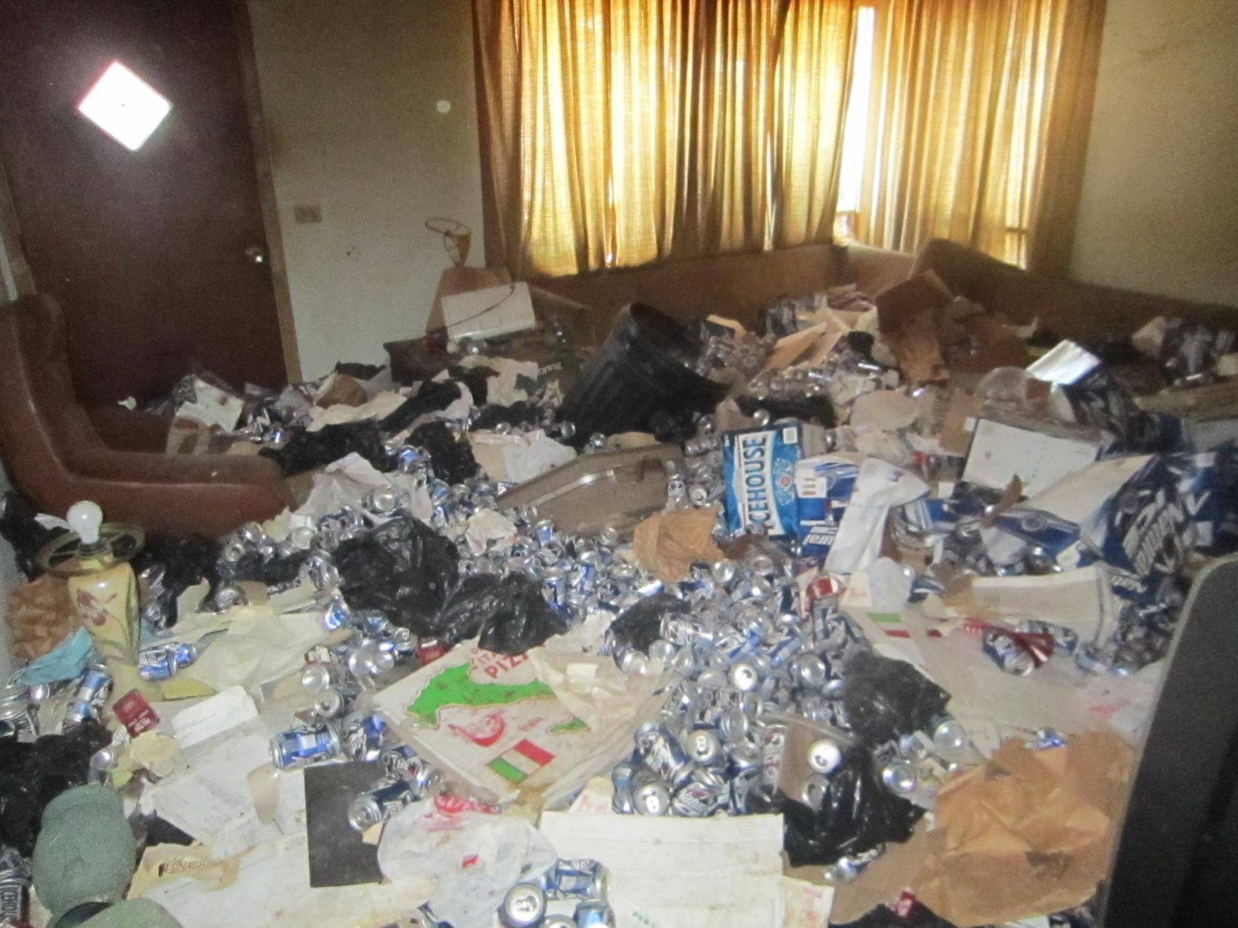

Slide 110
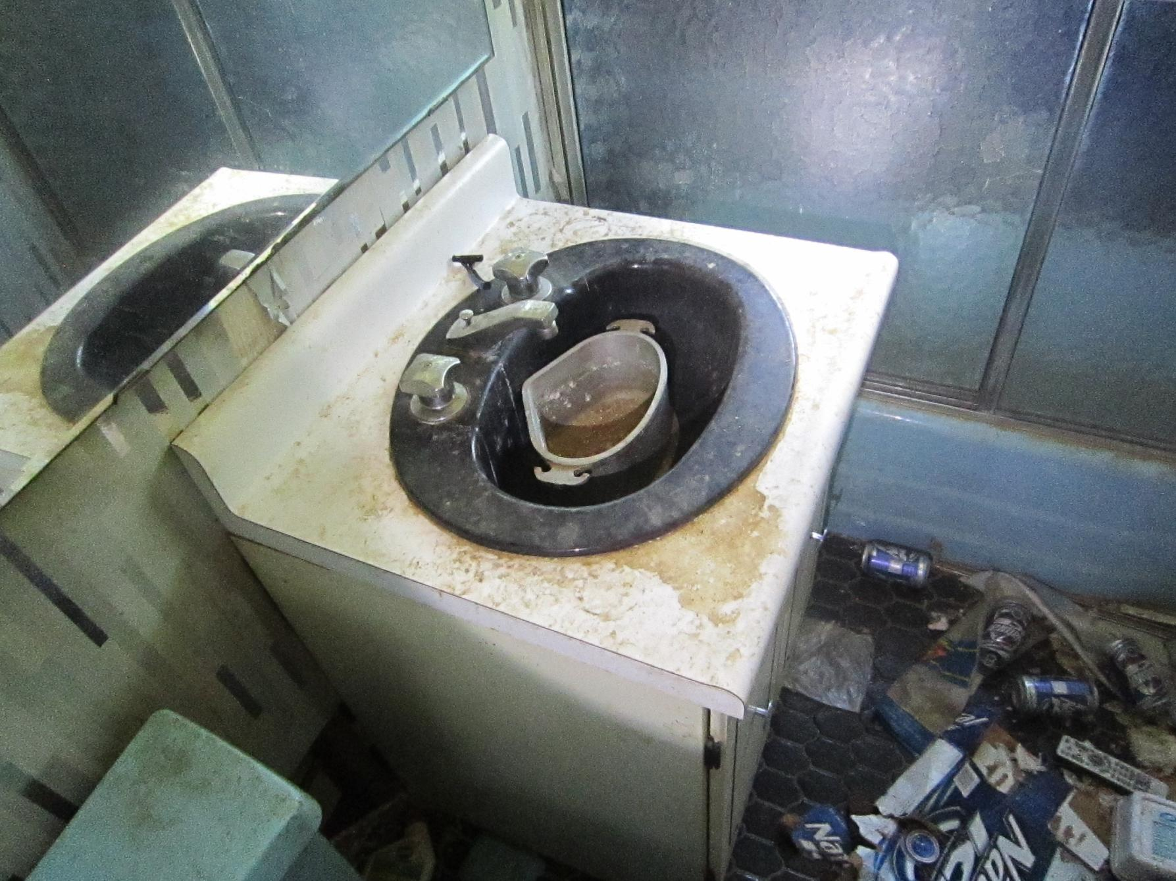

Slide 111
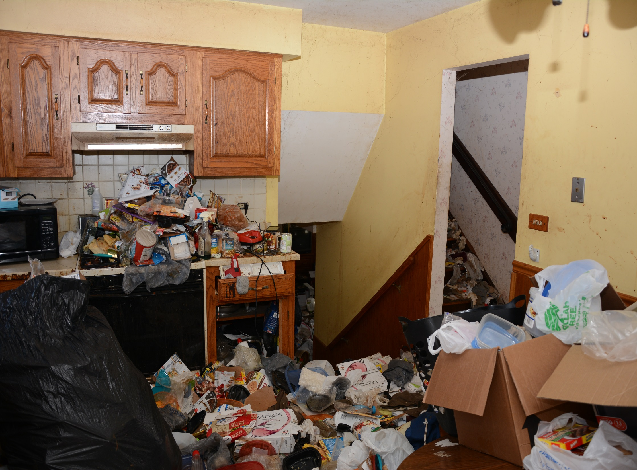

Slide 112
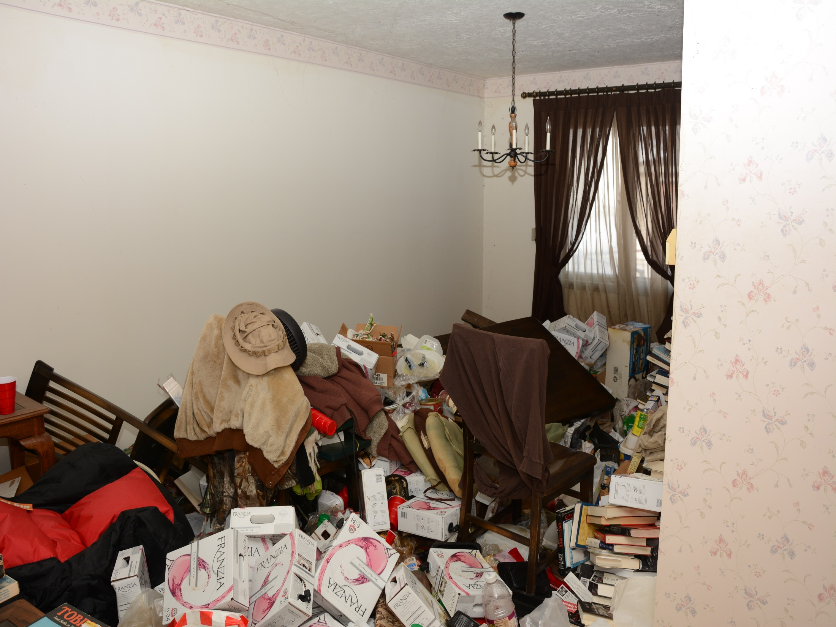

Slide 113
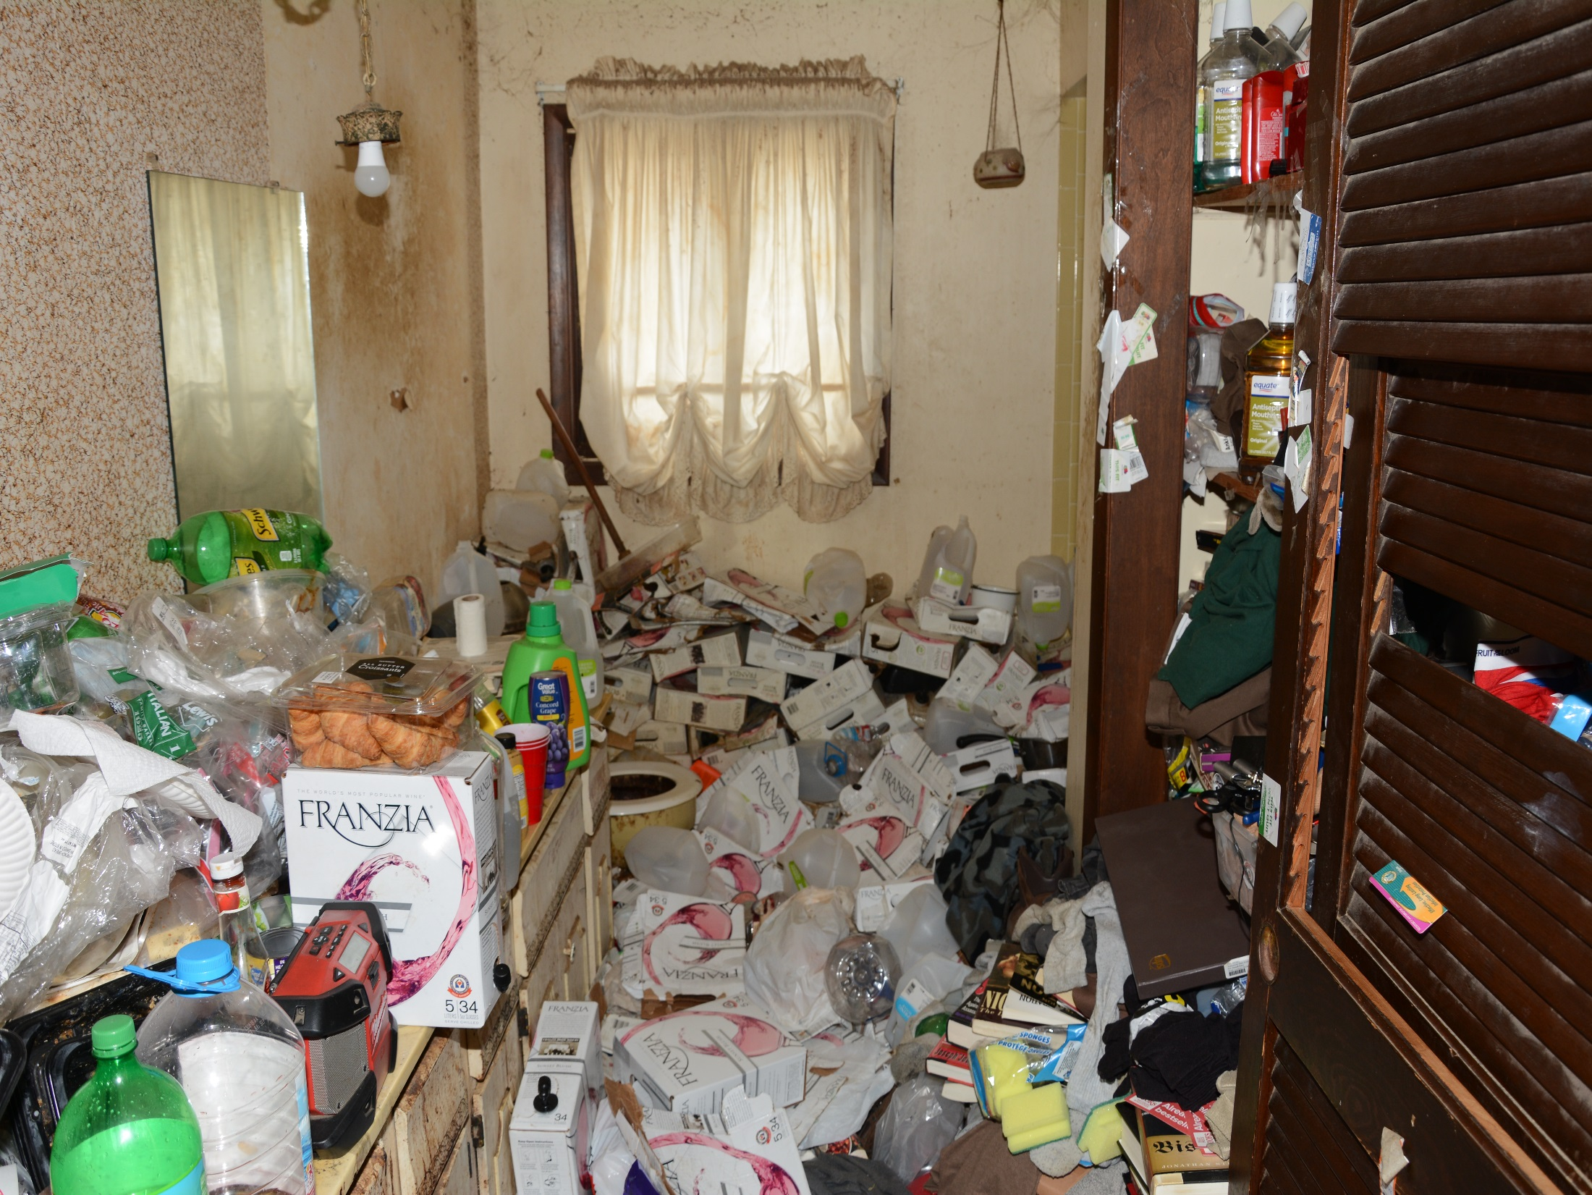

Slide 114
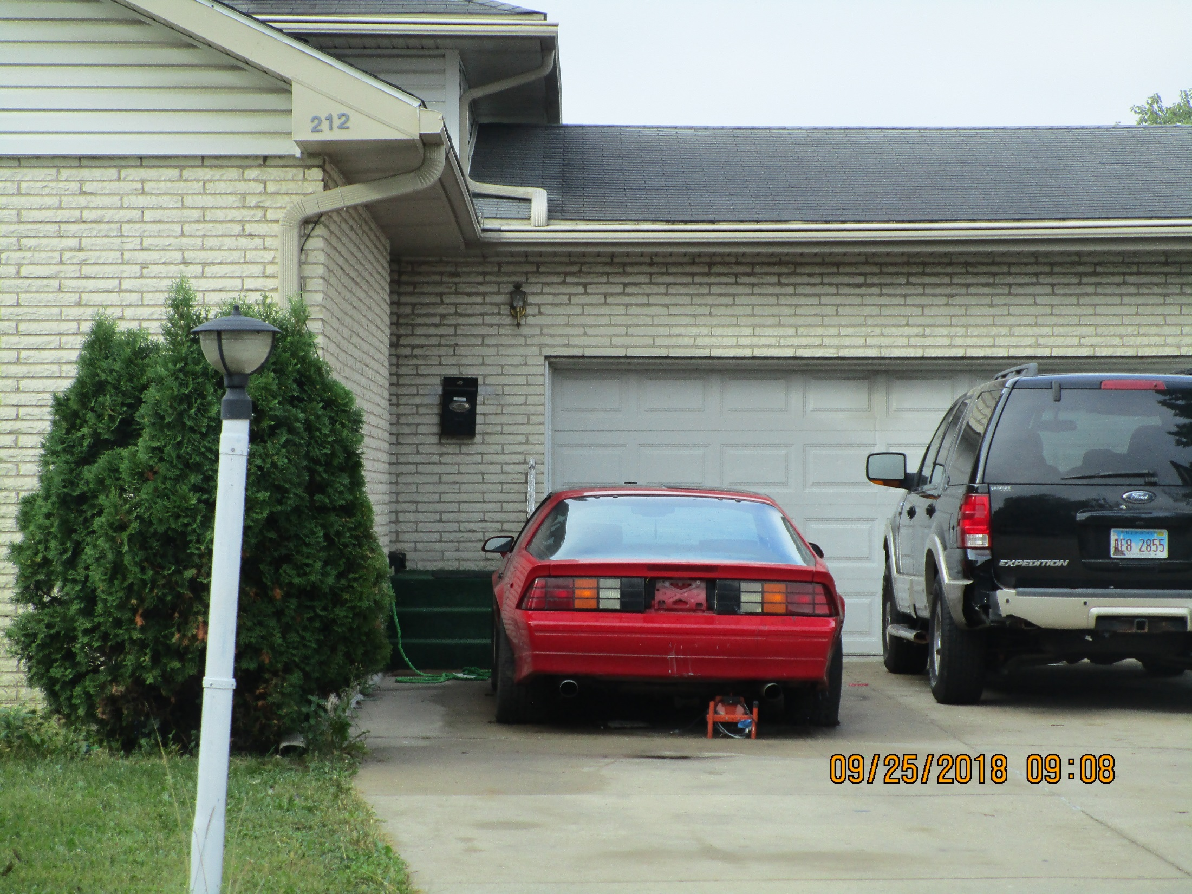

Slide 115
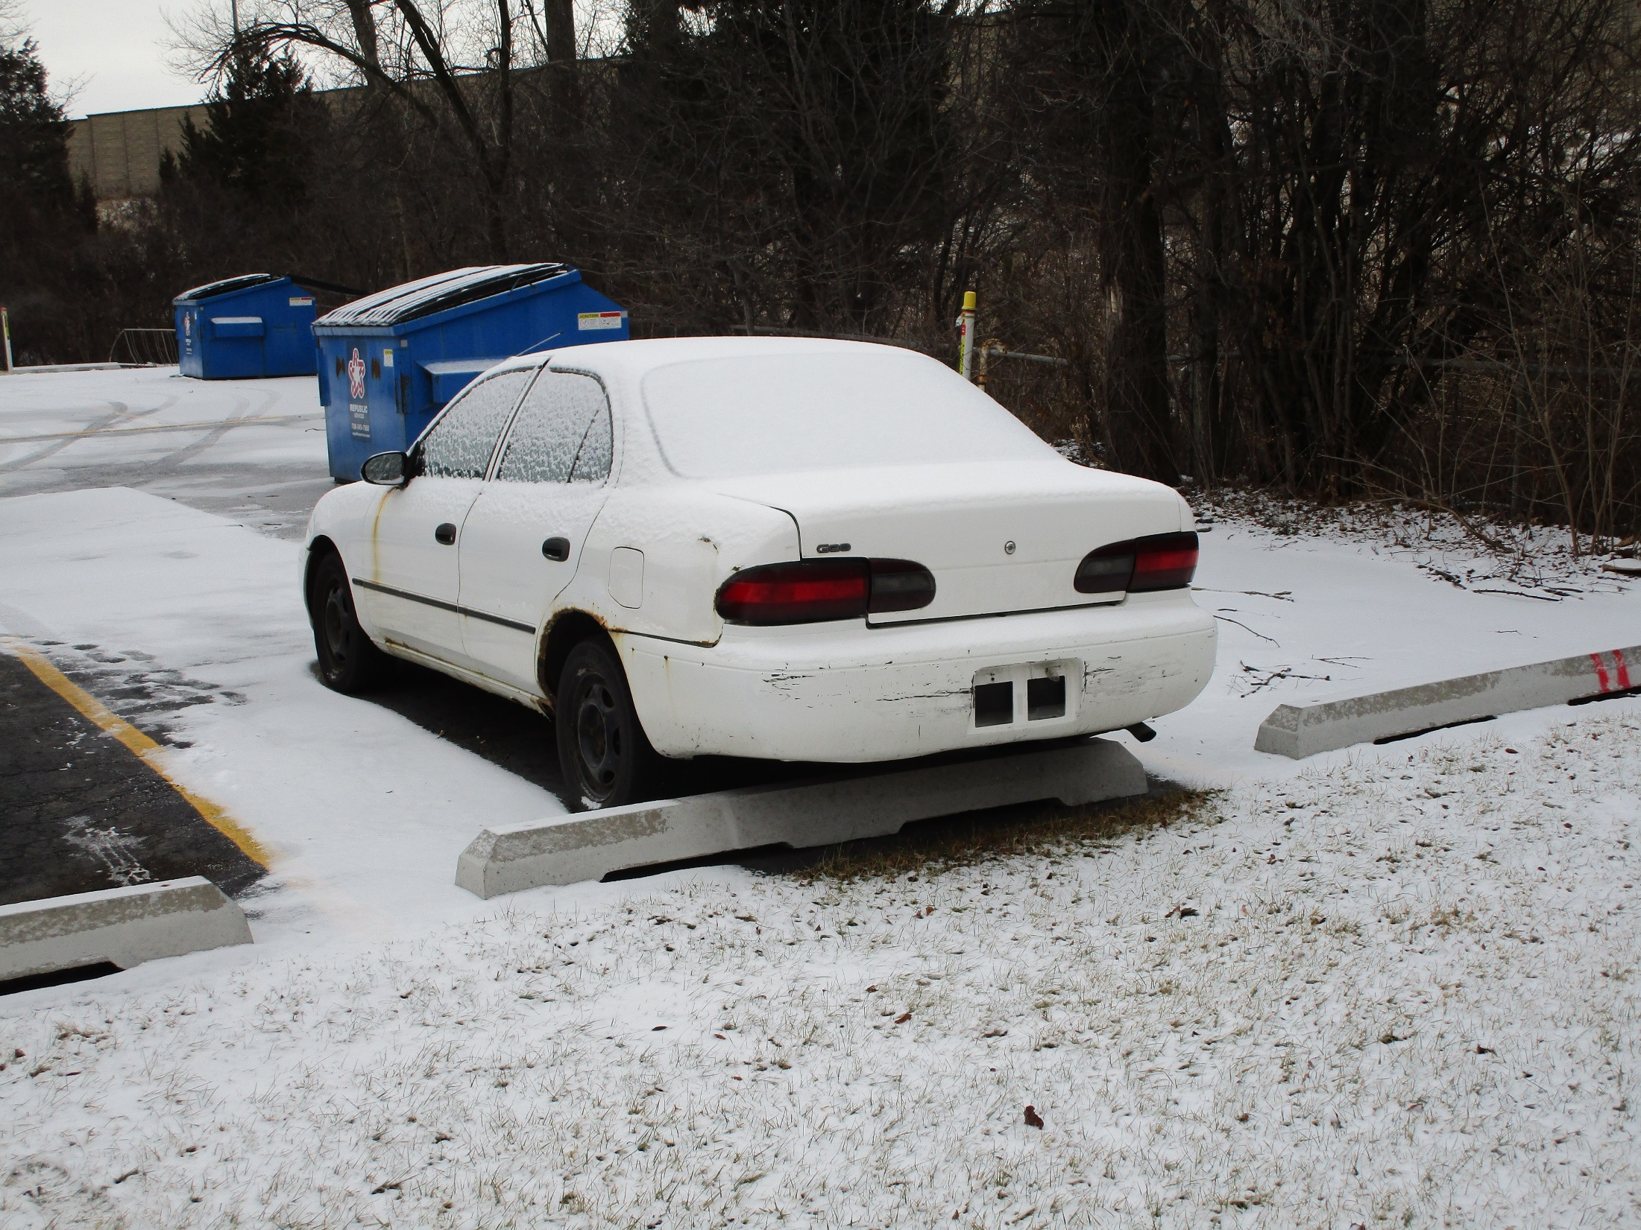

Slide 116
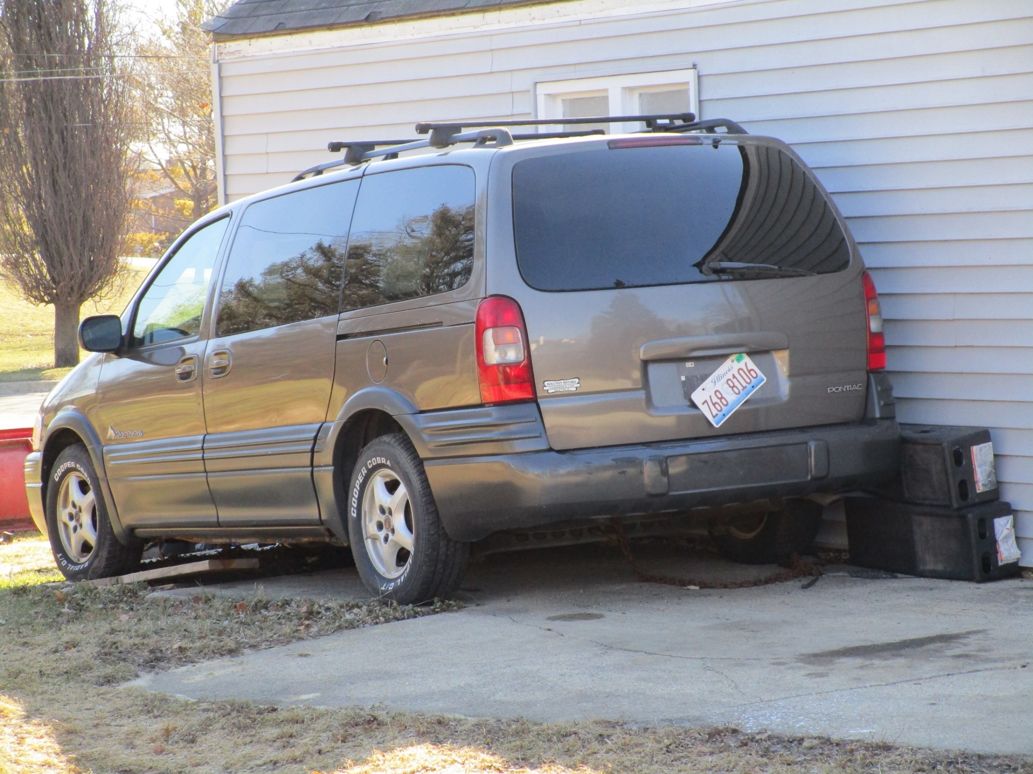

Slide 117
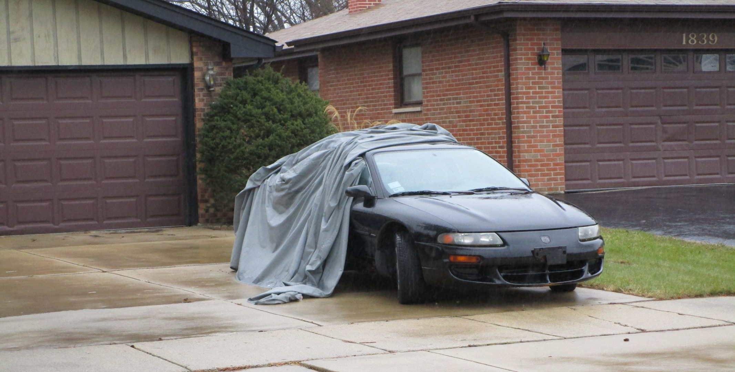

Slide 118
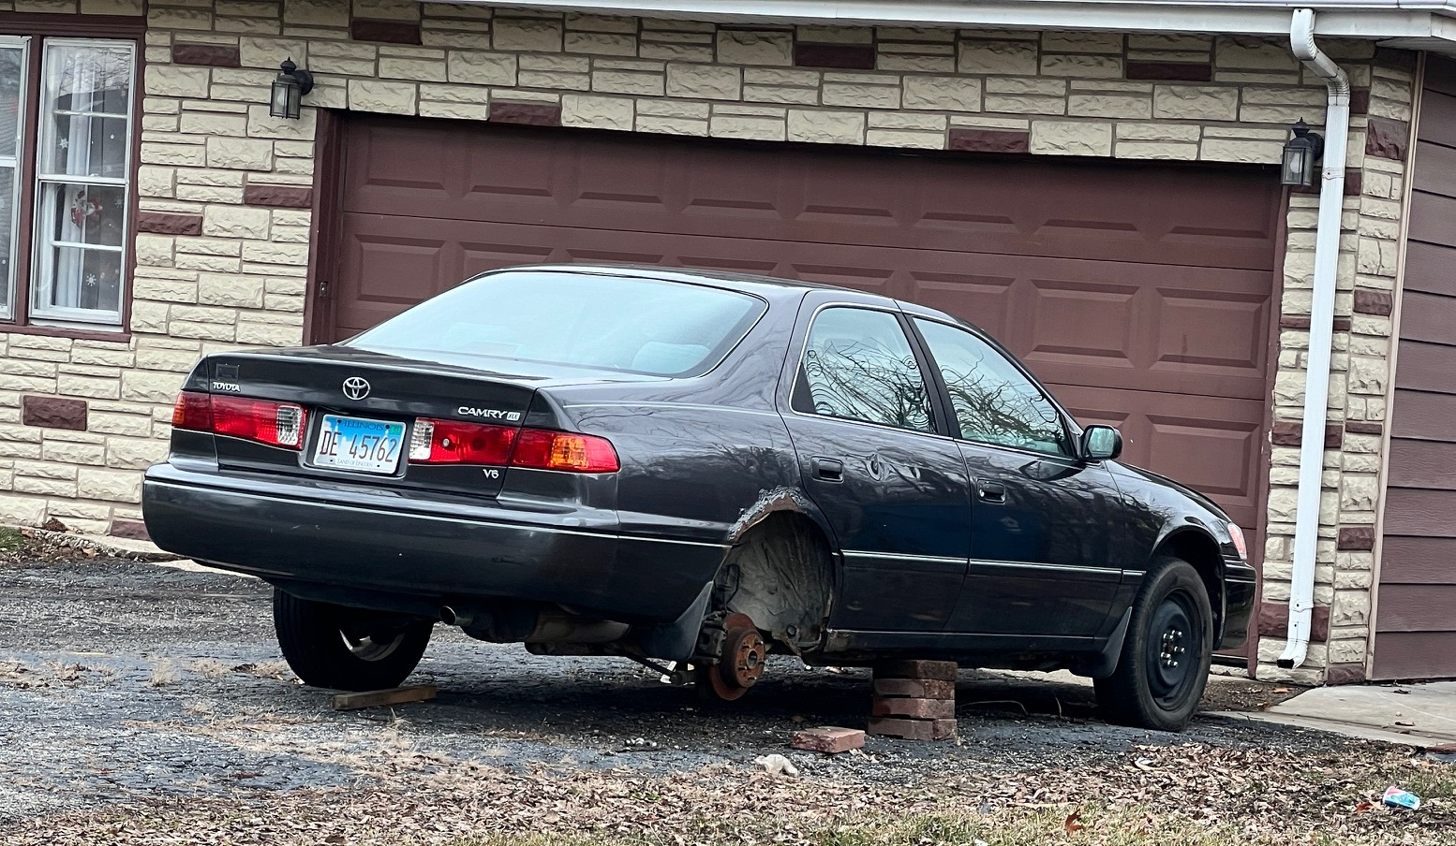

Slide 119

“Dear Property Owner ……”

Slide 120
GRAFFITI REMOVAL

Slide 121
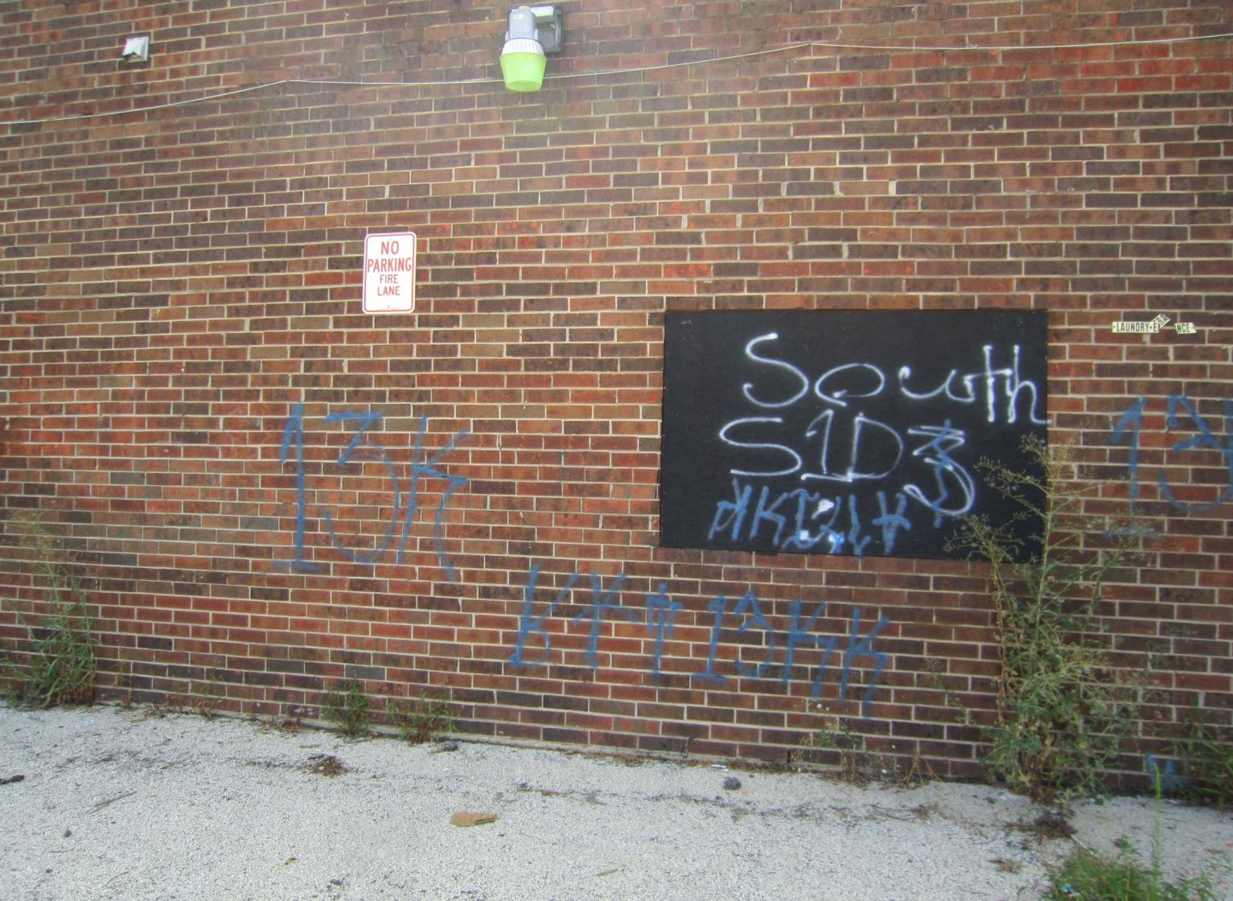

Slide 122


Slide 123
LOITERING

Slide 124

LET’S WORK TOGETHER !!!
LANDLORDS
POLICE
TENANTS
VILLAGE OF ADDISON

Slide 125

CRIME PREVENTION

Slide 126

“Confessions of a Burglar”
Video

Slide 128
Criminals Ask Themselves:
How easy will it be to enter the area?
How visible, attractive or vulnerable are the targets?
What are the chances of being seen?
If seen, what will anyone do about it?
- Sign complaints? Press charges? Won’t care?
Is there a quick escape route?

Slide 129


Slide 130


Slide 131


Slide 132


Slide 133


Slide 134


Slide 135


Slide 136


Slide 137

Broken Lamp (lack of care)

Slide 138

Bad Photocell or Timer Setting

Slide 139


Slide 140


Slide 141



Slide 142



Slide 143

LED LIGHT vs. HID LIGHT

Slide 144


Slide 146

What will your prospective tenants see when they drive past your rental property?

Slide 147
Territoriality
The “IMPRESSION” you get when you look at a property.
Two Components:
Maintenance: Upkeep, clean, no litter
Defensible Space: Private Space

Slide 148


Slide 149


Slide 150


Slide 151


Slide 152


Slide 153


Slide 154


Slide 155


Slide 156


Slide 157

Fencing
See-through and Proper Height

Slide 158


Slide 159
CFMH – Phase Two
Phase Two (Crime Prevention Through Environmental Design, or C.P.T.E.D.) will certify that the rental property has met the security requirements for the residents’ safety. The minimum requirements are…..

Slide 160
CFMH – Phase Two
Dead Bolts
Security Strike Plate Screws (2 ¾”)
View Finders on all Entry Doors
Anti Slide/Lock on Windows & Sliding Glass Doors
Adequate Lighting
Proper Landscaping

Slide 161


Deadbolts
On each apartment door
1-inch throw
Thumb turn from inside apartment

Slide 162



Security Strike Plates Screws (2 ¾”)
3 Inch
2 Inch
5/8 Inch

Slide 163





Slide 164

Wide-Angle Door View
(peep hole)
*** Install a minimum 180-degree door viewer ***

Slide 165




Anti-Slide Locks

Slide 166


Proper Landscaping

Slide 167


TOO MUCH ???

Slide 168


Slide 169
CFMH – Phase Three
Phase Three of the program is the Safety Social. A resident Crime Prevention meeting will be conducted where law enforcement will explain the program to the residents of the rental community.
- Residents learn what their role is to prevent crime and increase quality of life.

Slide 170


Slide 171


Slide 172


Slide 173


Slide 174


Slide 175


Slide 176


Slide 177


Slide 178


Slide 179


Slide 180


Slide 181


Slide 182


Slide 183
CFMH – Full Certification
Phase One is the only mandatory phase of the CFMH program. However, if all three phases are completed, the property becomes fully certified. The property owner receives a CFMH sign which can be posted on their building and the CFMH logo can be used in all advertising and correspondence.

Slide 184


Slide 185


Slide 186


Slide 187
Becoming Fully Certified -
What are the Benefits?
A stable, more satisfied resident base
Increased demand for rental units with a reputation for active management
Lower maintenance and repair costs

Slide 188
Becoming Fully Certified -
What are the Benefits?
Improved personal safety for residents and managers
Ability to recognize problems before they become critical situations
Better qualified renters = less “failure to pay rent”

Slide 189
Fully-Certified Properties
14 N. Church Street
902-948 College Blvd.
709 Georgian Court
610, 620, 622, 630 N. Lincoln Avenue
5 S. Lincoln Avenue
484 E. Lorraine
505 N. Macie Court
35 Michael Lane
163 Michael Lane
550-580 N. Mill Road
900 N. Rohlwing Rd.

Slide 190


Slide 191
The Crime Free
Multi-Housing Program
Legal Overview

Slide 192
ILLINOIS STATE LAWS
WWW.ILGA.GOV
(For Illinois Compiled Statutes)

Slide 193
Evictions:
When to consider evicting
Will you need an attorney
How much will it cost
5-, 10-, and 30-day notices
How to serve the tenant
What forms are used
What to bring to court

Slide 194
Evictions
When to consider:
Non-payment of rent
Non-compliance to lease terms
Drug use/illegal activity
(***Lease Addendum***)

Slide 195
Evictions
Do you need an attorney?
Highly recommended due to the required compliance to the statute
An attorney familiar with Forcible Entry and Detainer Act can cut down on continuances and save you money!

Slide 196
Evictions
How much will it cost?
The average cost for a
simple eviction in DuPage
County is $500 - $700

Slide 197
5-Day Notice
This type of notice is served when the tenant is behind in the payment of rent. It provides that if all amounts are not paid within five days, the landlord will terminate the lease. Only full payment should be accepted, any less and the partial payment may void the five-day notice.

Slide 198
10-Day Notice
This type of notice is given when there is a default of any of the terms of the lease. There is no other notice necessary to terminate the lease. This type of notice can be used in cases where a tenant engaged in behavior which disturbs the peace, damages property or otherwise is prohibited under the terms of the lease such as the Crime Free Lease Addendum.

Slide 199
30-Day Notice
This notice is used to terminate a tenant who is occupying the premises on a month- to-month basis or whose lease term is close to expiration.

Slide 200
Evictions
How to Serve the Tenant:
Certified mail with return receipt
Give notice to the tenant personally
Give notice to someone over the age of 13 who lives with the tenant

Slide 201
Evictions
What to bring to court:
Signed lease
Signed copy of notice
Copy of complaint
Copy of proof of proper service
Any other documents that support your claim against the tenant

Slide 202
Evictions
5 Steps of an Eviction:
Notice (serve the tenant)
Lawsuit (if tenant fails to correct violation)
Court Hearing (prove that you have used the correct notice, the lease has been terminated, and you have a right to possession of the property)

Slide 203
Evictions
5 Steps of an Eviction:
Order for Possession (if judge rules in your favor; will include a “stay” of the judgment, which is an amount of time the tenant has to move out)
Eviction (if tenant refuses to leave, the Sheriff can physically remove the tenant and possessions)

Slide 204
Visit our website!
www.addisonpoliceillinois.org
Information on the Crime Free Program
Village Ordinances directly related to this program
Crime Free Lease Addendum
A link to the Daily Bulletins
A link to our Freedom of Information Act request form (FOIA) to request copies of police reports
Officer names / contact information

